Slide 1



Standardize all the things:
Data standards development workshop
Charlie Barclay & Emma Griffiths
Centre for Infectious Disease Genomics and One Health (CIDGOH)
Simon Fraser University, Vancouver, Canada
Finlay Maguire
Faculty of Medicine, Faculty of Computer Science
Dalhousie University, Halifax, Canada
Data Structures Working Group, PHA4GE
October 24 2025
Cape Town, South Africa
What are we gonna standardize?

Slide 2
Agenda
Session 1 – Why standards matter
What are standards
Common challenges of contextual data and current standards development
Standards development framework and methodology overview
Practical guidance: scoping, needs assessment
Practical exercise: mock needs assessment
Session 2 – Standardizing terms and Ontologies
Ontology overview
Ontologies vs specifications vs tools
Practical guidance: framework reuse and tools for sourcing standardized terms
Practical exercise: EBI OLS searching and evaluating results
Session 3 – Implementations and Testing
Creating templates
Curation, validation, automated transformation: The DataHarmonizer
PHA4GE subgrants as mechanisms for testing
Data stewardship, Funding
Practical guidance: creating a specification, implementation in a tool, providing curation guidance
Practical exercise: SARS-CoV-2 template testing

Slide 3
Learning Objectives
Name different kinds of data standards
Describe the necessary resources for standards development (funding, expertise, personnel)
Describe the challenges of pathogen genomics contextual data
Articulate data standards principles and best practices
Perform standards scoping reviews and needs assessments
Understand benefits and functions of ontologies
Differentiate ontologies from specifications from data management tools
Use the CIDGOH standards framework for structuring standards
Use ontology look-up services for identifying appropriate standardized terms
Create a LinkML-style specification
Learn about available data collection/curation tools
Describe the importance of supporting materials in operationalizing standards
Describe data stewardship practices

Slide 4
Part 1: Why Standards Matter
Lecture
What are standards
Common challenges of contextual data and current standards development
Standards development framework and methodology overview
Practical guidance: scoping, needs assessment
Practical exercise
mock needs assessment

Slide 5

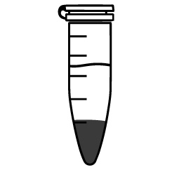

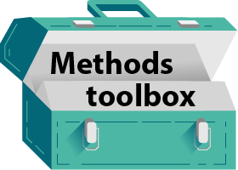

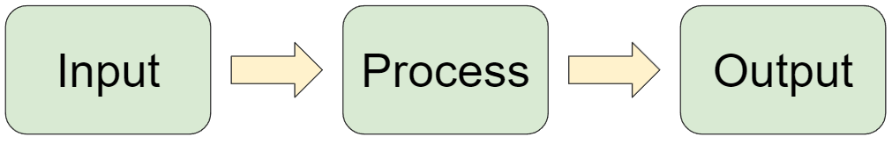
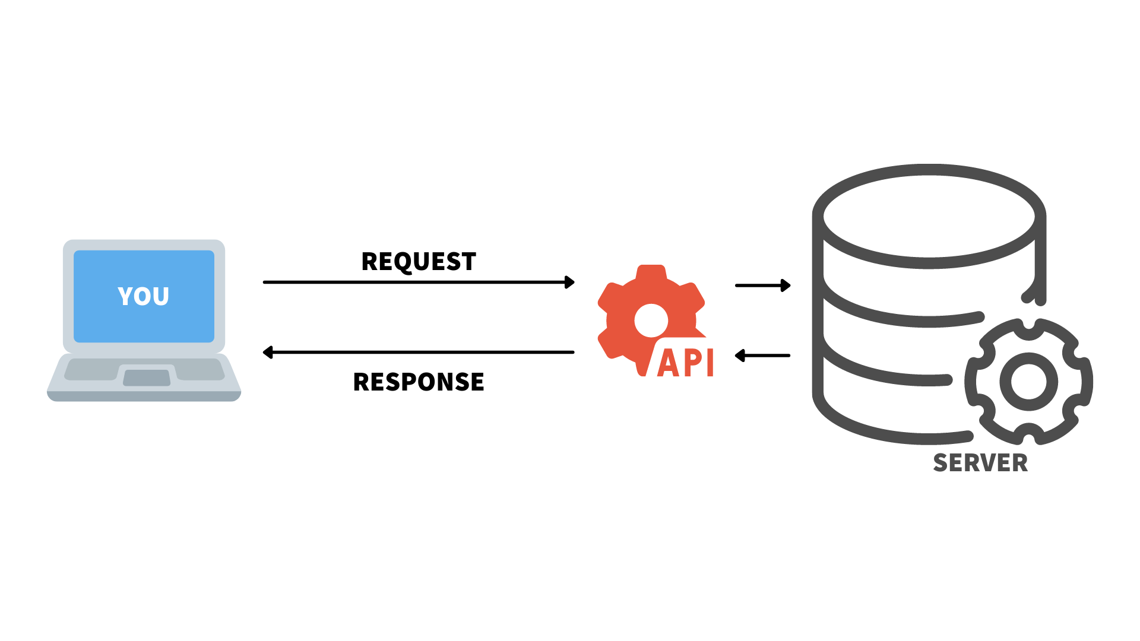
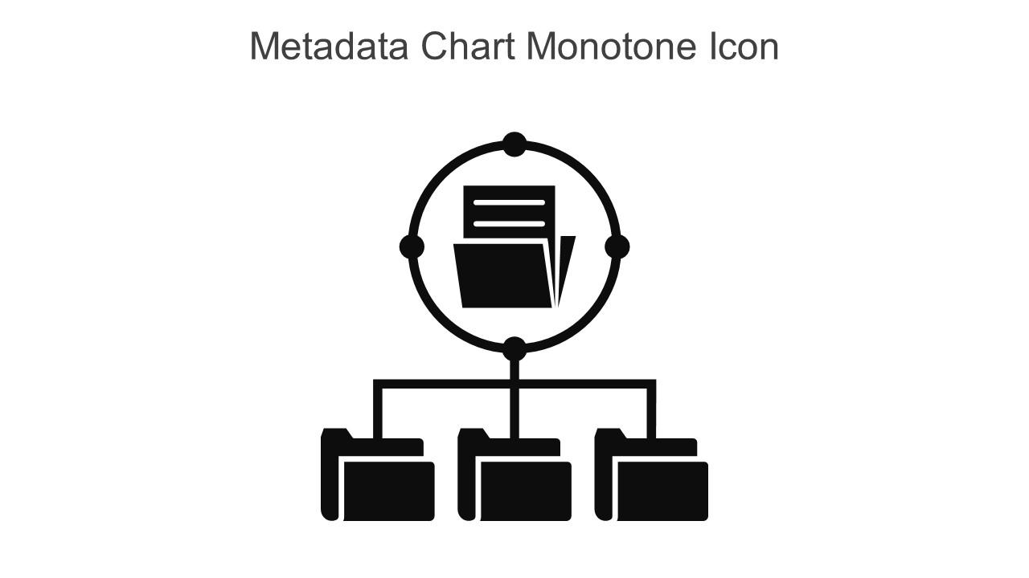
How data standards can facilitate public health pathogen bioinformatics and data sharing
Sets of recommended controlled vocabulary, formats, data structures, and rules, for storing, transferring, and expressing information.
Authoritative source. Uptake.
contextual data
(sequence record)
metrics & thresholds
derived/aggregated data
(reports/presentations)
inputs and outputs of analytical processes
services
systems structure

Slide 6


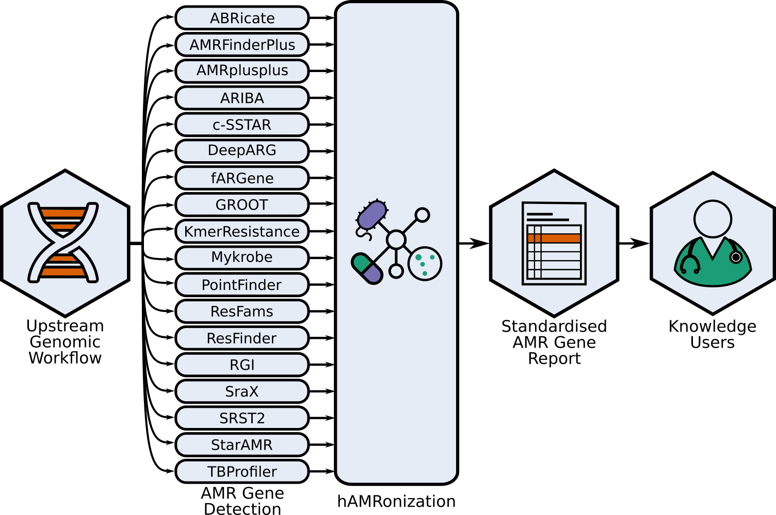
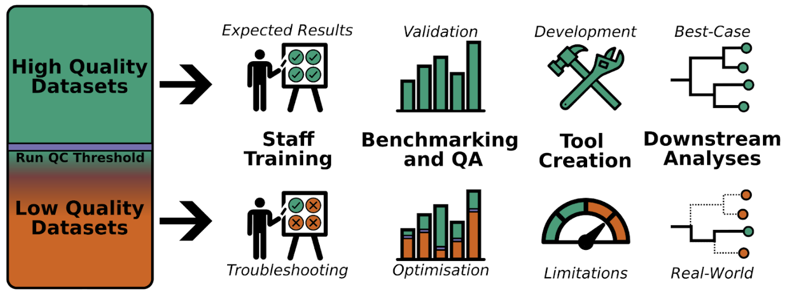
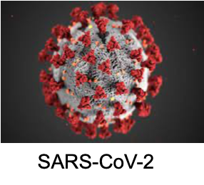
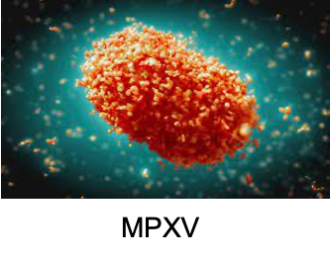
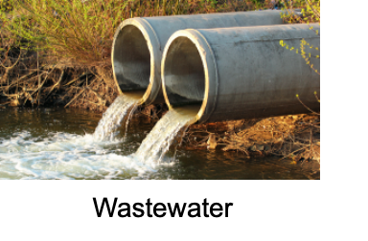
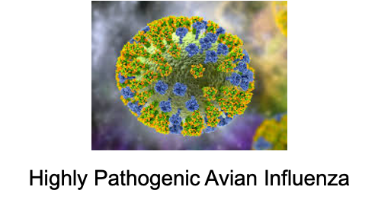

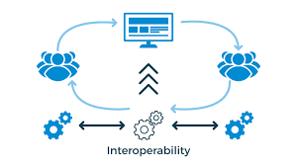
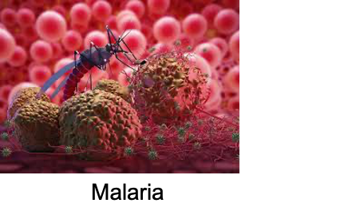
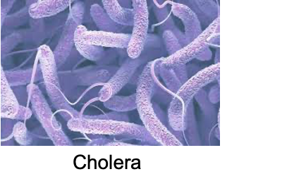

Growing ecosystem of interoperable specifications
Contextual Data Specifications
Bioinformatics Specifications
hAMRonization
QC tags
Microbial Typing
Specification
Bioinformatics Interoperability
Standards
Sample Complexity Standards (WIAS)
sample
Pathogen DOM

Slide 7


Contextual data is critical for interpreting the sequence data.
Sequence data
Contextual data (metadata) used for surveillance and outbreak investigations:
characterize lineages, sequence types, clusters
identify variants with clinical significance
correlate genomics trends with outcomes, risk factors
Monitoring and quality control
Comparing results between laboratories
Generating hypotheses about sources of infection/transmission etc
inform decision making for public health responses and monitor effects of interventions
Contextual data
Sample metadata
Lab results
Clinical/Epi data
Methods

Slide 8

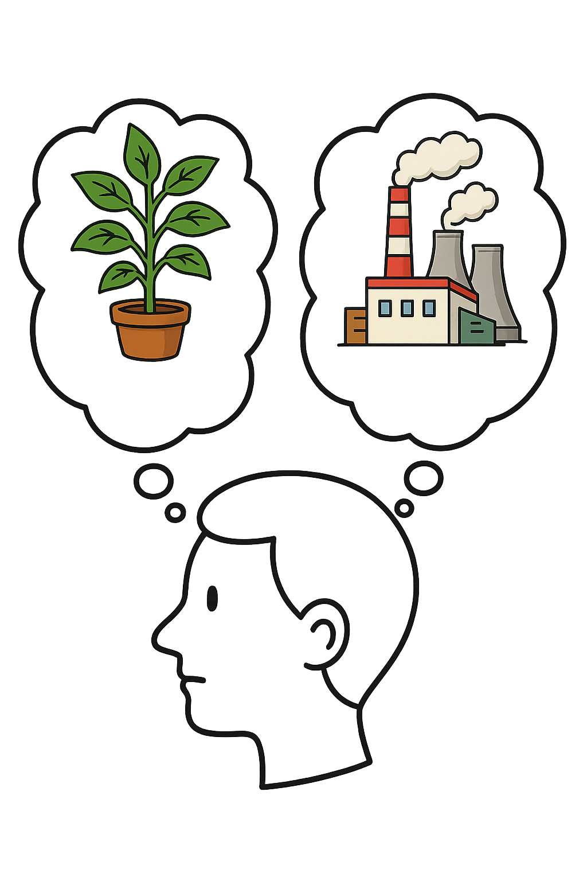
Your analysis is only as good as your contextual data
Lack of standardization complicates using the data.
Free text =
Errors, Jargon
& Short hand
Semantic ambiguity
Different
Data Structures
Arrugila
Slamonella
Layer crumb
Pizza pocket
Frz Chick Brst
Date:
2021-04-26
April 26, 2021
“Sample source”
In Lab A, it means Lab name
Formats
Concepts/entities/granularity
“Sample source”
In Lab B, it means Sample type
Poultry
Chicken
Skinless, boneless chicken breast
RTE Cajun style nuggets
Chicken offal excluding liver

Slide 9
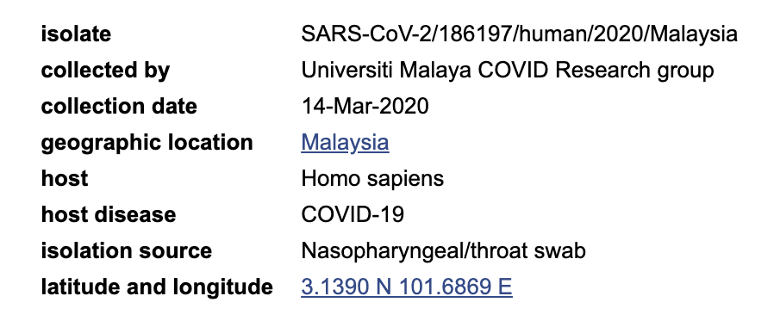
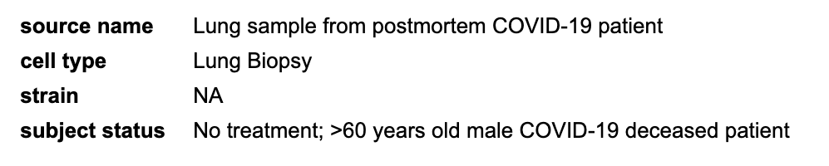
Variability in private databases propagates out to public repositories, complicating data integration/analyses.
Data structure impacts function.
It’s difficult to fit it all together. Data clean up takes time, resources.

Slide 10
Benefits of implementing standards
Part of quality management systems, data stewardship best practices
Improve clarity of meaning of information
Enhanced efficiency (reduce data cleaning, fewer errors), helps builds trust
Increased interoperability, streamline data flow between tools/systems
International standards helps improve governance and implementation

Slide 11
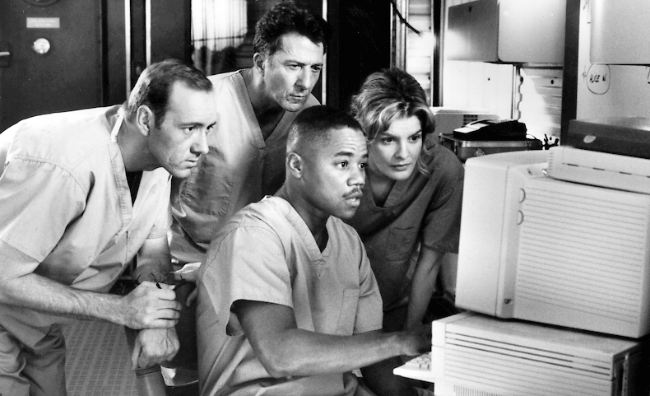
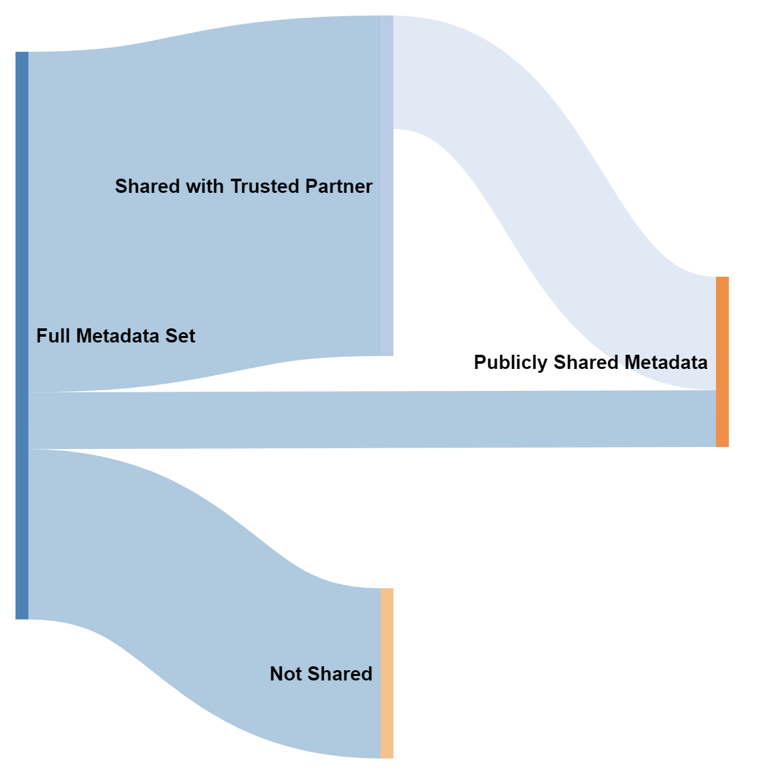
Considerations for pathogen genomics data standards
1. Multiple jurisdictions/authorities
centralized vs federated systems
different policies/rules, different data needs
different chains of command, data access, privacy offices etc
different types of information are in different places
2. Different kinds of sharing
within organizations, between trusted partners, public
3. Auditability
documented evidence for decision-making (methods, QC)
track chains of custody
accreditation
4. Pathogen-specific vs emergency vs general/routine data needs
5. Privacy/practical/ethical considerations
(Dramatic representation from the movie Outbreak)

Slide 12





Challenges of Status Quo in Standards Development
Expert consultation
Use case-specific vocabulary
Often result in:
Organization-specific and sector-specific vocabularies
Public repository/public database requirements
Issues:
Narrowly-focused OR overly broad (gaps)
Lack interoperability
Difficult to implement (lack of tools/support materials/training)
Developed for highly resourced organizations

Slide 13
Data standards development is a data science
communities of practice
semantic resources & best practices for machine readability and interoperability
design patterns, principles, data modelling languages
standardize data for routine use/analyses, improve communication, prepare data for more complex querying, AI (machine learning, NLP)
tools, implementation strategies, also known pitfalls, challenges
implementation in software is not new, BUT implementation in public health is cutting edge

Slide 14
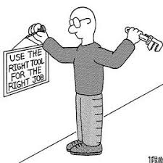
Developing data standards requires experience and expertise.
What you will learn in this workshop:
How to assess need for a new standard and determine its scope
How to perform effective needs assessment to identify data elements
How to use framework as foundation for interoperable standards
How to standardize vocabulary using ontologies and tools
How to create LinkML specifications
How to provide data stewardship considerations as guidance for data collection/sharing
How to set up a good test of a data standard
Advice for funding
What you won’t learn in this workshop:
How to build other types of standards
How to build ontologies (OWL, synonymy, logical relations RO), hierarchies (BFO/COB), deprecation, orthogonality, Aristotelian definitions)
How to create new standardized terms (10 Simple Rules, minting, editing, tracking, new term requests across ontologies)
OBO Foundry community of practice/rules
How to develop your own data collection tool
How to develop a graph database
Anything AI

Slide 15



Data standards best principles and practices
Technical Practice | Benefit
-Open source, available in a common formal language -Make machine-readable specifications available in different formats, e.g. JSON, YAML, csv (e.g. LinkML) -Use best practices for creating new vocabulary avoid pre-composed terms. abbreviations, Boolean values in data collection; separate proper nouns and descriptors, adhere to structural language patterns -Consider use cases beyond immediate scope | Vocabulary is understandable by humans and computers. Vocabulary is well defined, and the use of identifiers reduces ambiguity of meaning. Vocabulary is as universal avoiding organization-specific usage of language (i.e. reusable). Data elements are easier to index, catalogue, and compare across studies and surveillance initiatives.
Support data collection globally, interoperability with other standards
Supports analysis for common use cases
Enables the identification of potential bias and/or limitations of the data
Supports different kinds of data sharing
Is established as a standard by consensus, including experts from different countries and settings

Slide 16
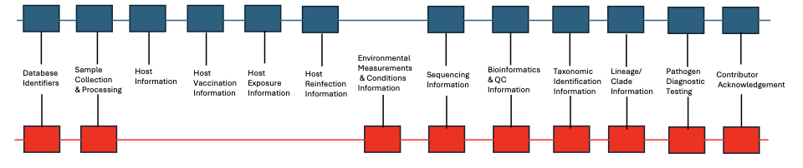
Structure: Modular, interoperable data standard design
Modular framework and core content (ISO 23418:22)
Supported by tooling and reference material
Maintained, version-controlled
Encourage communication between developers and users
Modules populated with fields/terms from community-driven ontologies + existing standards
Mpox Specification Modules
Wastewater Specification Modules

Slide 17
Standards development: 10 Simple Rules
Step 1: Identify need for the specification
Define the challenge that could be solved by a new data standard.
Step 3: Perform a data needs assessment
Make a list of relevant stakeholders and conduct consultations. Review existing resources (standards, databases, collection instruments, etc.). Summarize anticipated analytical needs from different use cases.
Step 5: Develop interchange mappings
Facilitate data sharing by mapping to downstream databases. Use exchange formats and tools to automate transformations between resources.
Step 7: Testing, testing, and more testing
Iteratively test, review, and improve the specification package using real data, data collection, and data management practices.
Step 9: Update the specification as needs evolve
Use version control, document discussions, encourage transparency, engage the community for feedback, and track issues.
Step 2: Define the goal and scope of the specification
Identify specification scope, stakeholders, as well as content types and boundaries.
Step 4: Draft a preliminary schema using a consensus approach
Draft specification using existing terminology and formats. Develop new vocabulary following best semantic and ontology practices.
Step 6: Develop materials to support operationalizing the specification
Create reference guides and curation protocols. Integrate the specification in data management tools to create a clear path to implementation.
Step 8: Document real-world implementations
Gather real world examples of implementations to demonstrate utility and use.
Step 10: Encourage community participation in standards development
Share/disseminate novel standardized vocabulary and the complete specification schema.
Notes:
https://spec.cidgoh.ca/challenges

Slide 18
Build Your Own Standard: An Overview
Step 1: Do you really need a new specification?
What are you trying to do?
Does a standard already exist that you could use?
Tricky. Standards are in different repos, publications, websites, etc.
Best bet – PHA4GE/IPSN Data Standards Registry, MIxS packages
If yes, can you use it directly or does it need to be customized?
If no, proceed to Step 2.

Slide 19
Build Your Own Standard: An Overview
Step 2: Defining the scope of your new standard.
Define the problem statement.
Describe the lack of existing standards for the domain, and the gaps/challenges this creates.
Define the target audience and describe the boundaries for the standard (what’s in, what’s out).
Use the DATA STANDARD SCOPING TOOL.

Slide 20
Build Your Own Standard: An Overview
Step 3: Perform a needs assessment to understand data needs
Who do you need to talk to? Make a list of stakeholders.
Identify public health questions being asked.
Understand data needed to answer questions.
Catalogue data types being collected (make a list).
Identify data management & sharing challenges.
*check if you need a research ethics review
Use the NEEDS ASSESSMENT QUESTIONNAIRE.

Slide 21
Key topics for needs assessment
Goal: Understand questions, processes used, data needed to answer the questions
Review scope
Sampling strategies (hosts, sampling events, locations/anatomical parts/devices/methods etc)
Sample characterization, Processing, Sample Storage, Library prep, Sequencing, Bioinformatics methods
Governance (rules, communicating biases/limitations of data, licensing/tagging, what should/could be in data sharing agreements)
Technical details: Pathogen nomenclature, typing and diagnostic testing methods, genetic features
Tools & analyses (software, reference databases, outputs)
Data management & flow (spreadsheets, LIMS, trusted partners, public repos)
Wishlist/challenges/opportunities
IRIDA

Slide 22

Explain goals and their rights.
Listen with empathy.
Note challenges (you’ll need to create a summary/report later, share with stakeholders).
Remember the scope!
Guide the discussion.
Note the names/affiliations of all participants for acknowledgement.
(avoid conflating issues – convincing decision makers, sourcing reagents, funding, use case barriers)

Slide 23
Practicum:
Needs Assessment Exercise

Slide 24
Part 2: Standardizing Terms and Ontologies
Lecture
Ontology overview
Ontologies vs specifications vs tools
Practical guidance: framework reuse and tools for sourcing standardized terms
Practical exercise
EBI OLS searching and evaluating results

Slide 25
Standards development: 10 Simple Rules
Step 1: Identify need for the specification
Define the challenge that could be solved by a new data standard.
Step 3: Perform a data needs assessment
Make a list of relevant stakeholders and conduct consultations. Review existing resources (standards, databases, collection instruments, etc.). Summarize anticipated analytical needs from different use cases.
Step 5: Develop interchange mappings
Facilitate data sharing by mapping to downstream databases. Use exchange formats and tools to automate transformations between resources.
Step 7: Testing, testing, and more testing
Iteratively test, review, and improve the specification package using real data, data collection, and data management practices.
Step 9: Update the specification as needs evolve
Use version control, document discussions, encourage transparency, engage the community for feedback, and track issues.
Step 2: Define the goal and scope of the specification
Identify specification scope, stakeholders, as well as content types and boundaries.
Step 4: Draft a preliminary schema using a consensus approach
Draft specification using existing terminology and formats. Develop new vocabulary following best semantic and ontology practices.
Step 6: Develop materials to support operationalizing the specification
Create reference guides and curation protocols. Integrate the specification in data management tools to create a clear path to implementation.
Step 8: Document real-world implementations
Gather real world examples of implementations to demonstrate utility and use.
Step 10: Encourage community participation in standards development
Share/disseminate novel standardized vocabulary and the complete specification schema.
Notes:
https://spec.cidgoh.ca/challenges

Slide 26
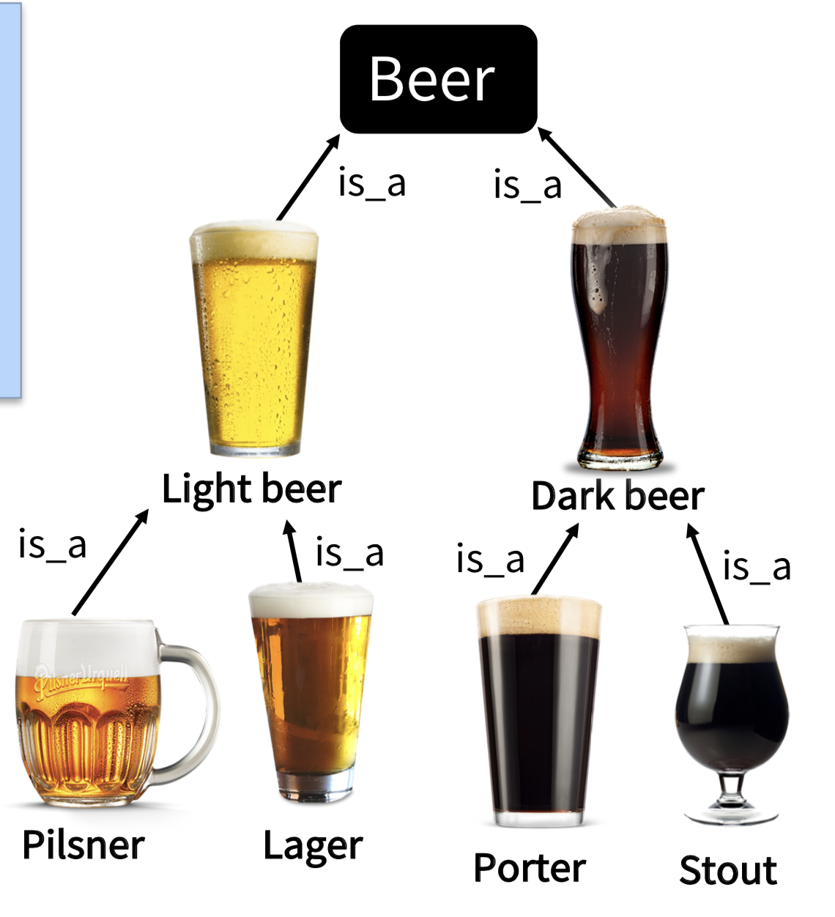
Ontologies: Built for harmonization and data linkage
Controlled (standardized) vocabulary
Hierarchy + logic (linked data, enable classification for analyses)
Universality
Meanings disambiguated with URIs
Labels/Synonyms (organization-specific/interoperability)
Principles and practices to enable reuse (BFO, RO)
Community
Community of practice (OBO Foundry, >200 interop ontologies)
Registries/Portals (EBI OLS, Ontobee, BioPortal)
Languages/Tools (Protégé, LinkML, Robot, OntoFox)
FAIR
has_ingredient
has_quality
produced_by
Lager beer [BeerO:1234]
Common, findable, interoperable, accessible, interoperable language

Slide 27
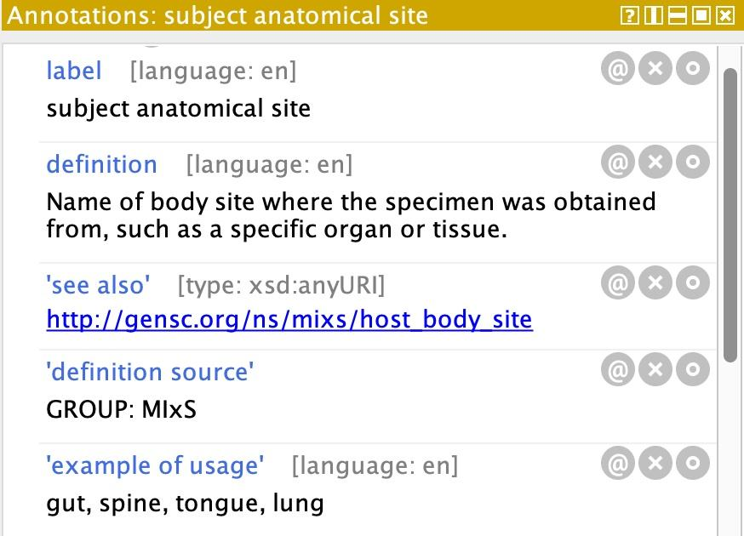
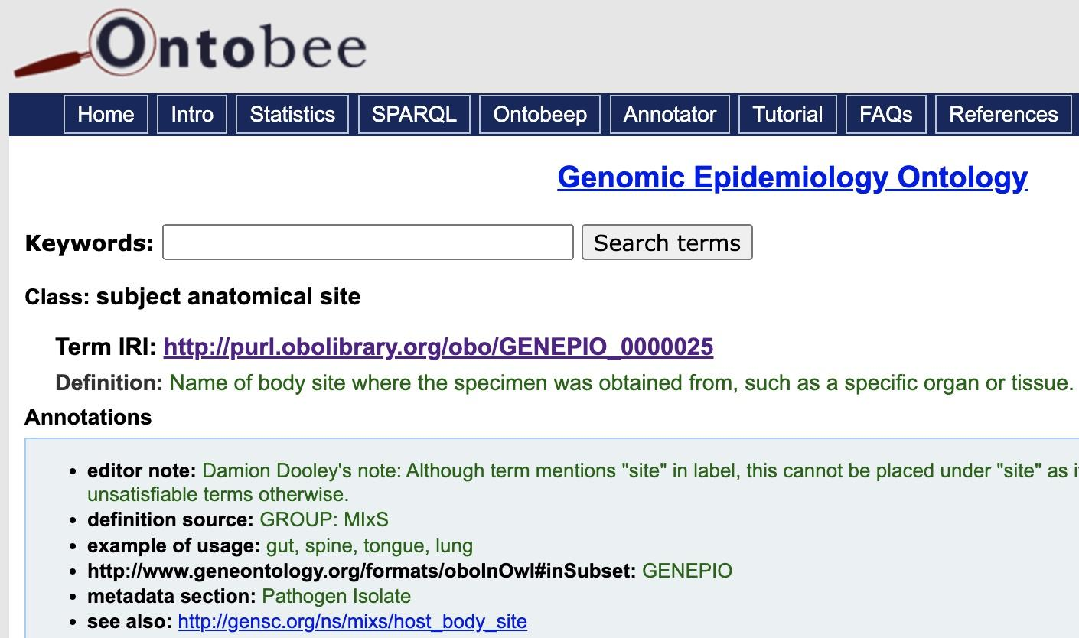
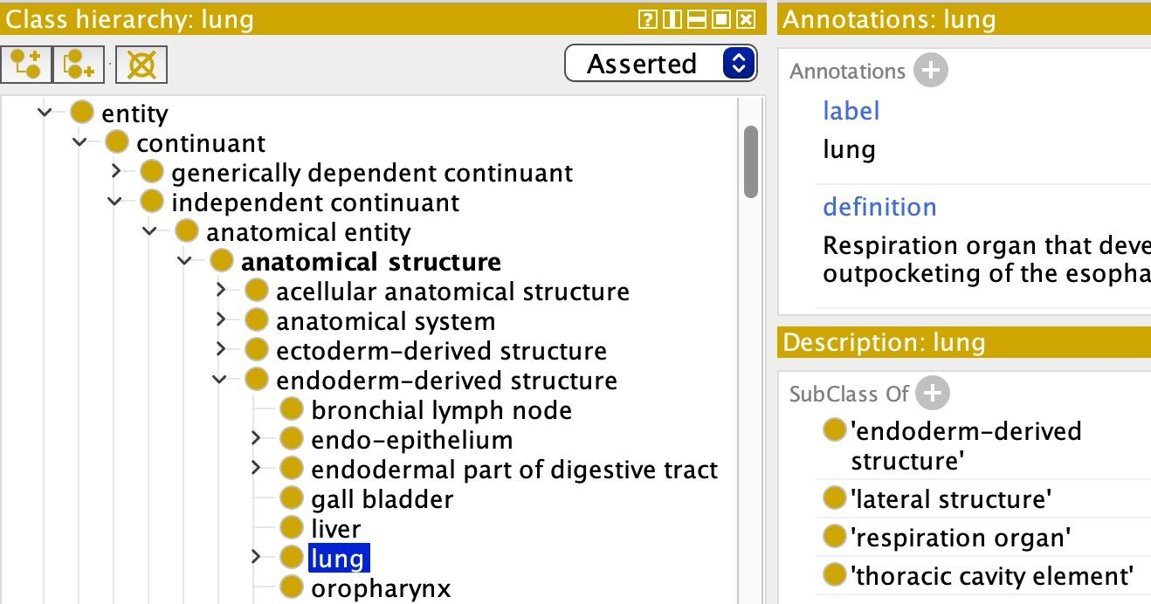
Protégé/OWL:
Label, definition, examples
Synonyms, cross-references
Hierarchy (parent-child relationships)
Relations, axioms
Identifier tracking
OBO:
Identifier space
Best practices (e.g. reuse/orthogonality)

Slide 28







Genomic Epidemiology Ontology (GenEpiO)
www.genepio.org
Griffiths et al (2017), Frontiers in Microbiology
Aim: integrating genomics, lab, clinical and epidemiological data critical for WGS-based microbial pathogen investigations
Environments
Anatomy & Body Products
Taxonomy
Assays, Methods, Devices
Information Entities
Genomics
>6500 terms for describing samples, contexts, instruments, analyses
sample collected by [GENEPIO:0001153]
purpose of sampling [GENEPIO:0001198]
anatomical part [GENEPIO:0001214]
host (scientific name) [GENEPIO:0001387]
quality control method name [GENEPIO:0100557]
Examples of terms:
Notes:
One Health approach to sample descriptions
Consortium key to help develop consensus and wide adoption, international input and expertise → emphasize community effort
Designed for supporting regulatory, surveillance, outbreak investigations, risk assessments and so on

Slide 29
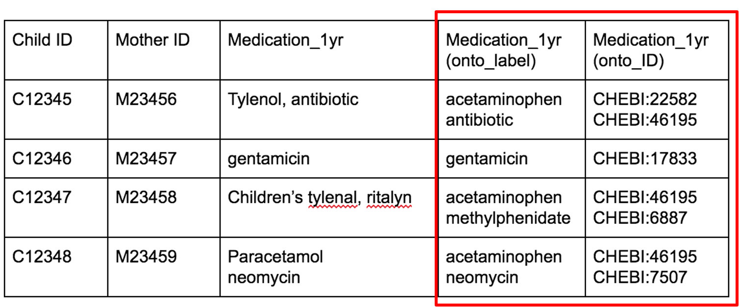
Annotating data with ontologies
Annotating data: adding standardized labels and IDs
NOTE: keep original data. Curation involves interpretation & subjectivity.
Chemical Entities of Biological Interest:
Ontology for small chemical compounds
CHILD Study: factors affecting the development of asthma and allergy in children
Messy data collection about drug exposures

Slide 30

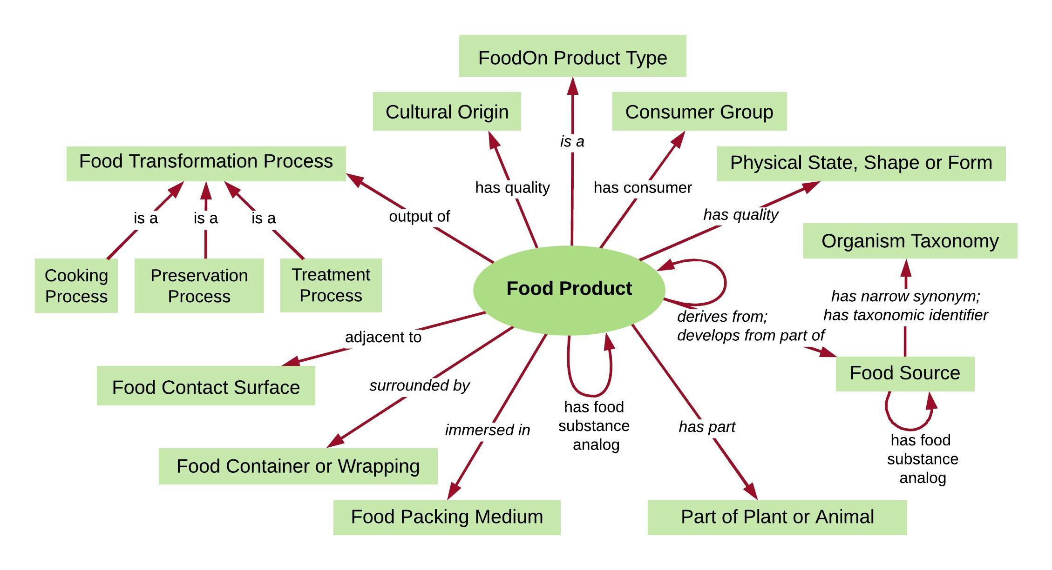
The Food Ontology (FoodOn)
>28K terms for food products, feed, sources and processes
interoperable architecture (OBO Foundry)
characterizes products by facets
enables mapping between international food schemes
FoodOn consortia (safety, security, recipes, robotics/
automation, nutrition)
Dooley, Griffiths et al (2018), Nature: Science of Food
https://github.com/FoodOntology/foodon
www.foodon.org
Notes:
An example of an ontology that our team has built is called FoodOn. Farm to fork ontology that provides standardized descriptors for food products, feed, food processes and food processing.
Built with OBO foundry structure and formats to increase interoperability with other ontologies
Foodon food products are characterized using different facets, and has queryable logic according to the facet
We are slowly incorporating high level food product categories from different agencies to enable mapping between different food classification schemes

Slide 31
Use of facets breaks down complex descriptions into standardized, mappable units
FOODON:03301570 - carrot root (raw, whole)
FOODON:03430119 – food (mashed)
“Organic mashed carrot baby food, jarred”
FOODON:03490215 - jar
Label
claim
Food
processing
Food product organismal source
Consumer
Food
packaging
FOODON:03510128 – organic food claim or use
FOODON:03510266 – infant as food consumer
FOODON:03302217 - carrot (strained, baby food)
FOODON:03411227 - carrot plant
NCBITaxon:4039 - Daucus carota

Slide 32
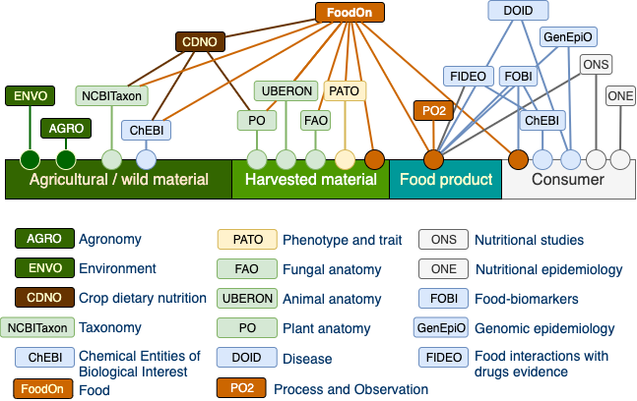
FoodOn Ecosystem
Notes:
Joint ontology Working group

Slide 33
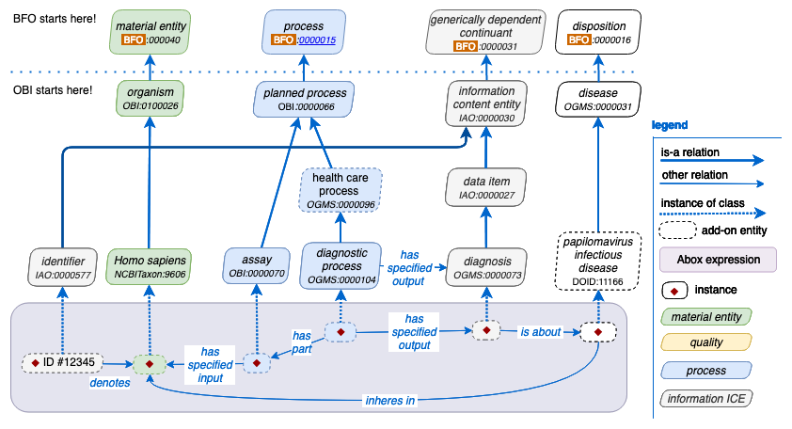
Ontologies can be used for data modelling and building graph databases
Positive HPV status for a head and neck cancer patient. Adapted from: http://ceur-ws.org/Vol-2285/ICBO_2018_paper_37.pdf
Notes:
A logician’s linguistics

Slide 34
Ontologies in Public Health
We are here!
Querying
and Reasoning
Problem: Consensus?
Qualitative and Quantitative Relations
Hierarchy: facets of description
Term Global Identifier: global standard
Data Dictionary: term label, definition and data type
Notes:
Bottom-up aspiration to graph databases.

Slide 35
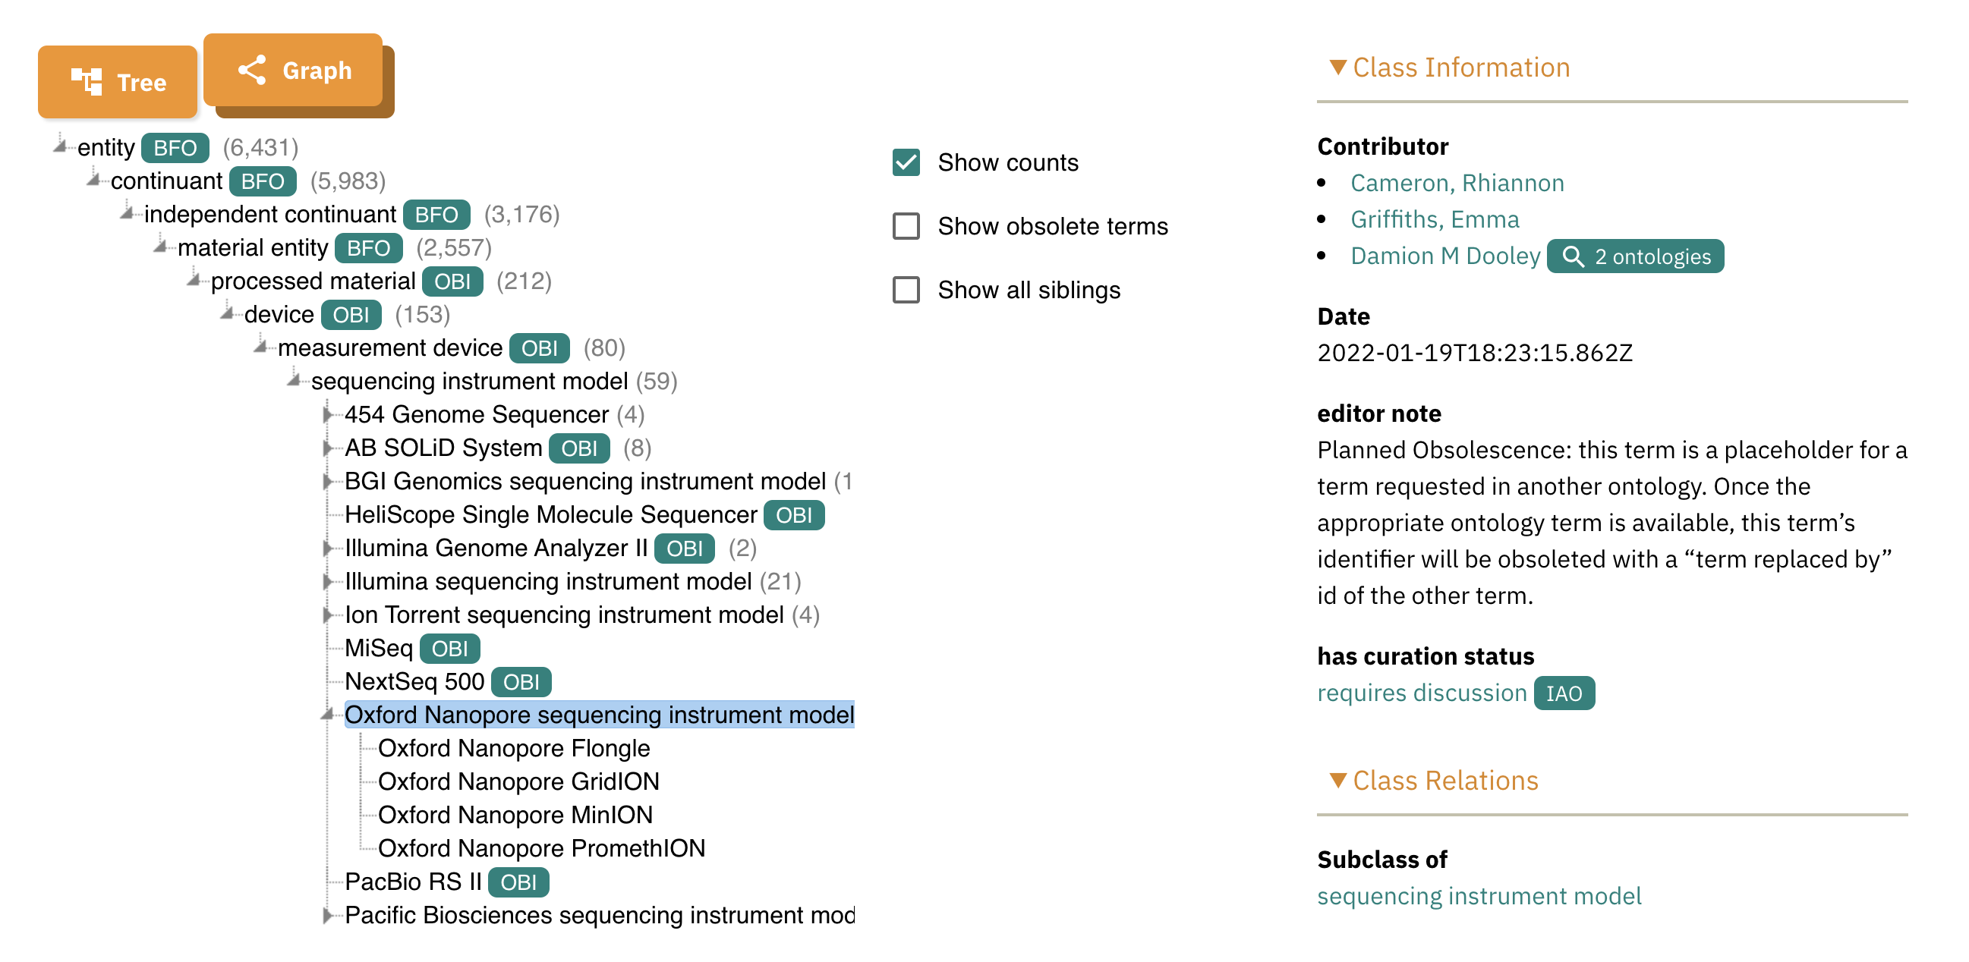
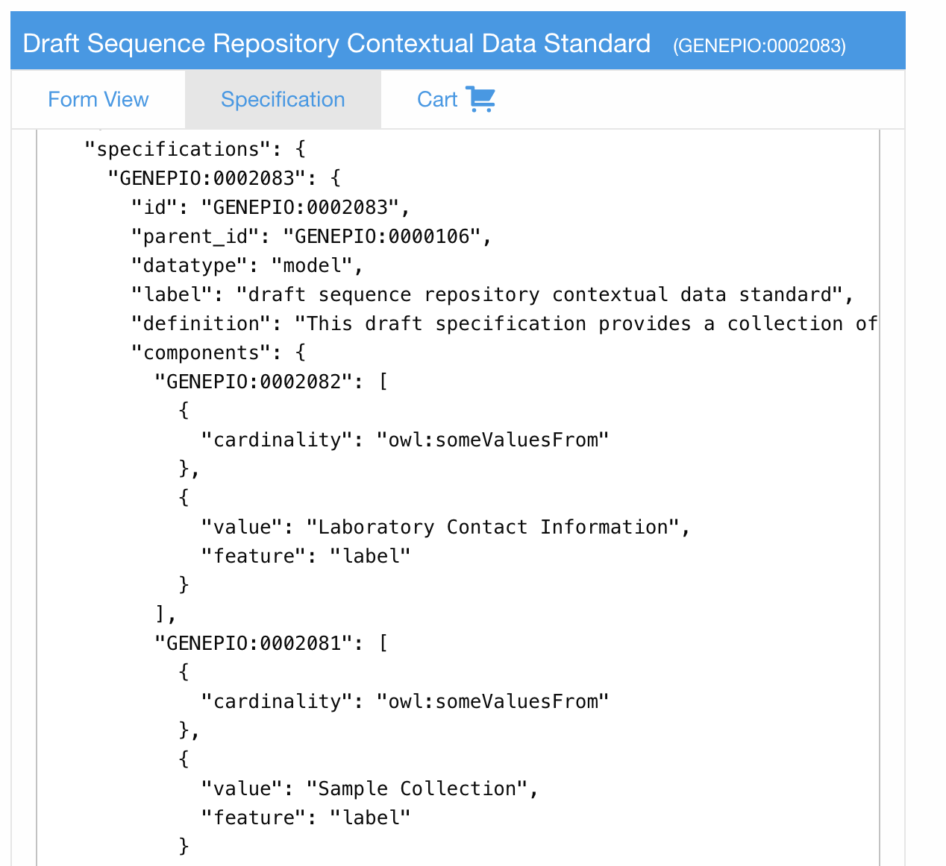
How data curation & management resources interact
Ontologies
Specifications
Hierarchies, logic, synonyms, annotations, (OWL)
EBI-OLS, Protege
Data types, rules, patterns, max/mins, formats (LinkML: tsv, JSON, YAML)

Slide 36
How data curation & management resources interact
Ontologies
Specifications
Tools & Data Management Systems
Spreadsheets
LIMS
Databases
Online/local tools
Look-up services
Curation tools
Validation tools
Transformation Tools
Mapping tools

Slide 37
Build Your Own Standard: An Overview
Step 4: Reuse what already exists
(no need to reinvent the wheel)!
Look at PHA4GE Minimal Metadata specification
Review CIDGOH Master list of modules/terms
Start with something that already exists (closest to your scope)
Identify changes e.g. new modules, fields, terms, guidance, validation
Use the MINIMAL METADATA SPEC & MASTER FIELD/TERM LIST.
Read 10 SIMPLE RULES FOR STANDARDIZING TERMS.

Slide 38
Standards Framework: Modules, Fields, Terms, other Specs
Modules (Master List)
Database identifiers
Sample collection and processing
Environmental conditions and measurements
Host information
Host vaccination information
Host exposure information
Host reinfection information
Sequence information
Bioinformatics and QC metrics
Lineage and variant information
Taxonomic identification information
Pathogen Diagnostic testing
Antimicrobial resistance testing
AMR detection information
Risk assessment information
Contributor acknowledgement
Field Master List
Database identifiers
specimen collector project ID
BioProject accession
BioSample accession
INSDC sequence read accession
INSDC assembly accession
GISAID accession
GISAID virus name
Pathoplexus accession
Term Master List
Host role
Patient [OMRSE:00000030]
Inpatient [NCIT:C25182]
Outpatient [NCIT:C28293]
Resident [GENEPIO:0100251]
Visitor [GENEPIO:0100252]
Worker [GENEPIO:0100254]
Minimal metadata
hAMRmonization
QC tags Specification
Amplicon Primer Scheme Specification
INSDC Pathogen DOM
Microbial Genotyping Specification
What if you need a type of information not already captured in an existing module?
CONTACT US. datastructures@pha4ge.org
We will always help.

Slide 39
Evolution of Standards Framework and Considerations for New Standards
SC2
-Previously E.coli/Listeria ad hoc studies
-viral
-respiratory testing
-amplicon sequencing
-passage history
-bioinfx processing
-PCR testing
-interop across systems (NML, GISAID, NCBI)
Mpox
-Reuse existing spec
-new sample types
-specify diagnostic targets within genes
-different types of transmission/exposures
OH-AMR
-Reuse existing spec but big modifications
-Bacteria
-environment, food, hosts (One Health)
-presampling activities
-sequencing assays (amplicon, culture & WGS, metagenomics)
-other data types
-AMR
WW
-Reuse existing spec but big modifications, new mods integrated into other specs (specs evolve)
-physico-chemical measurements and metrics
-primer panels
-new geo boundaries (polygons, shapefiles)
-aggregate demographics (catchments)
-controls
-enrichment
-presampling activities (e.g. Grit removal)
-linkage (sampling events, sites)
-use case customization
reuse
reuse
HPAI
-Reuse existing spec but big modifications
-segmented virus
-viral typing (clades, lineages, WHO lineages
-subunit typing schemes, amplicon schemes, ref sequences
-viral resistance
-wildlife
-land use
reuse

Slide 40
Build Your Own Standard: An Overview
Step 5: Standardize Terms
Look up vocabulary in an ontology look-up service.
Select best matches.
Collect label, definition, identifier.
Use EBI-OLS (https://www.ebi.ac.uk/ols4/) and the
NEW TERM REQUEST PROTOCOL.

Slide 41
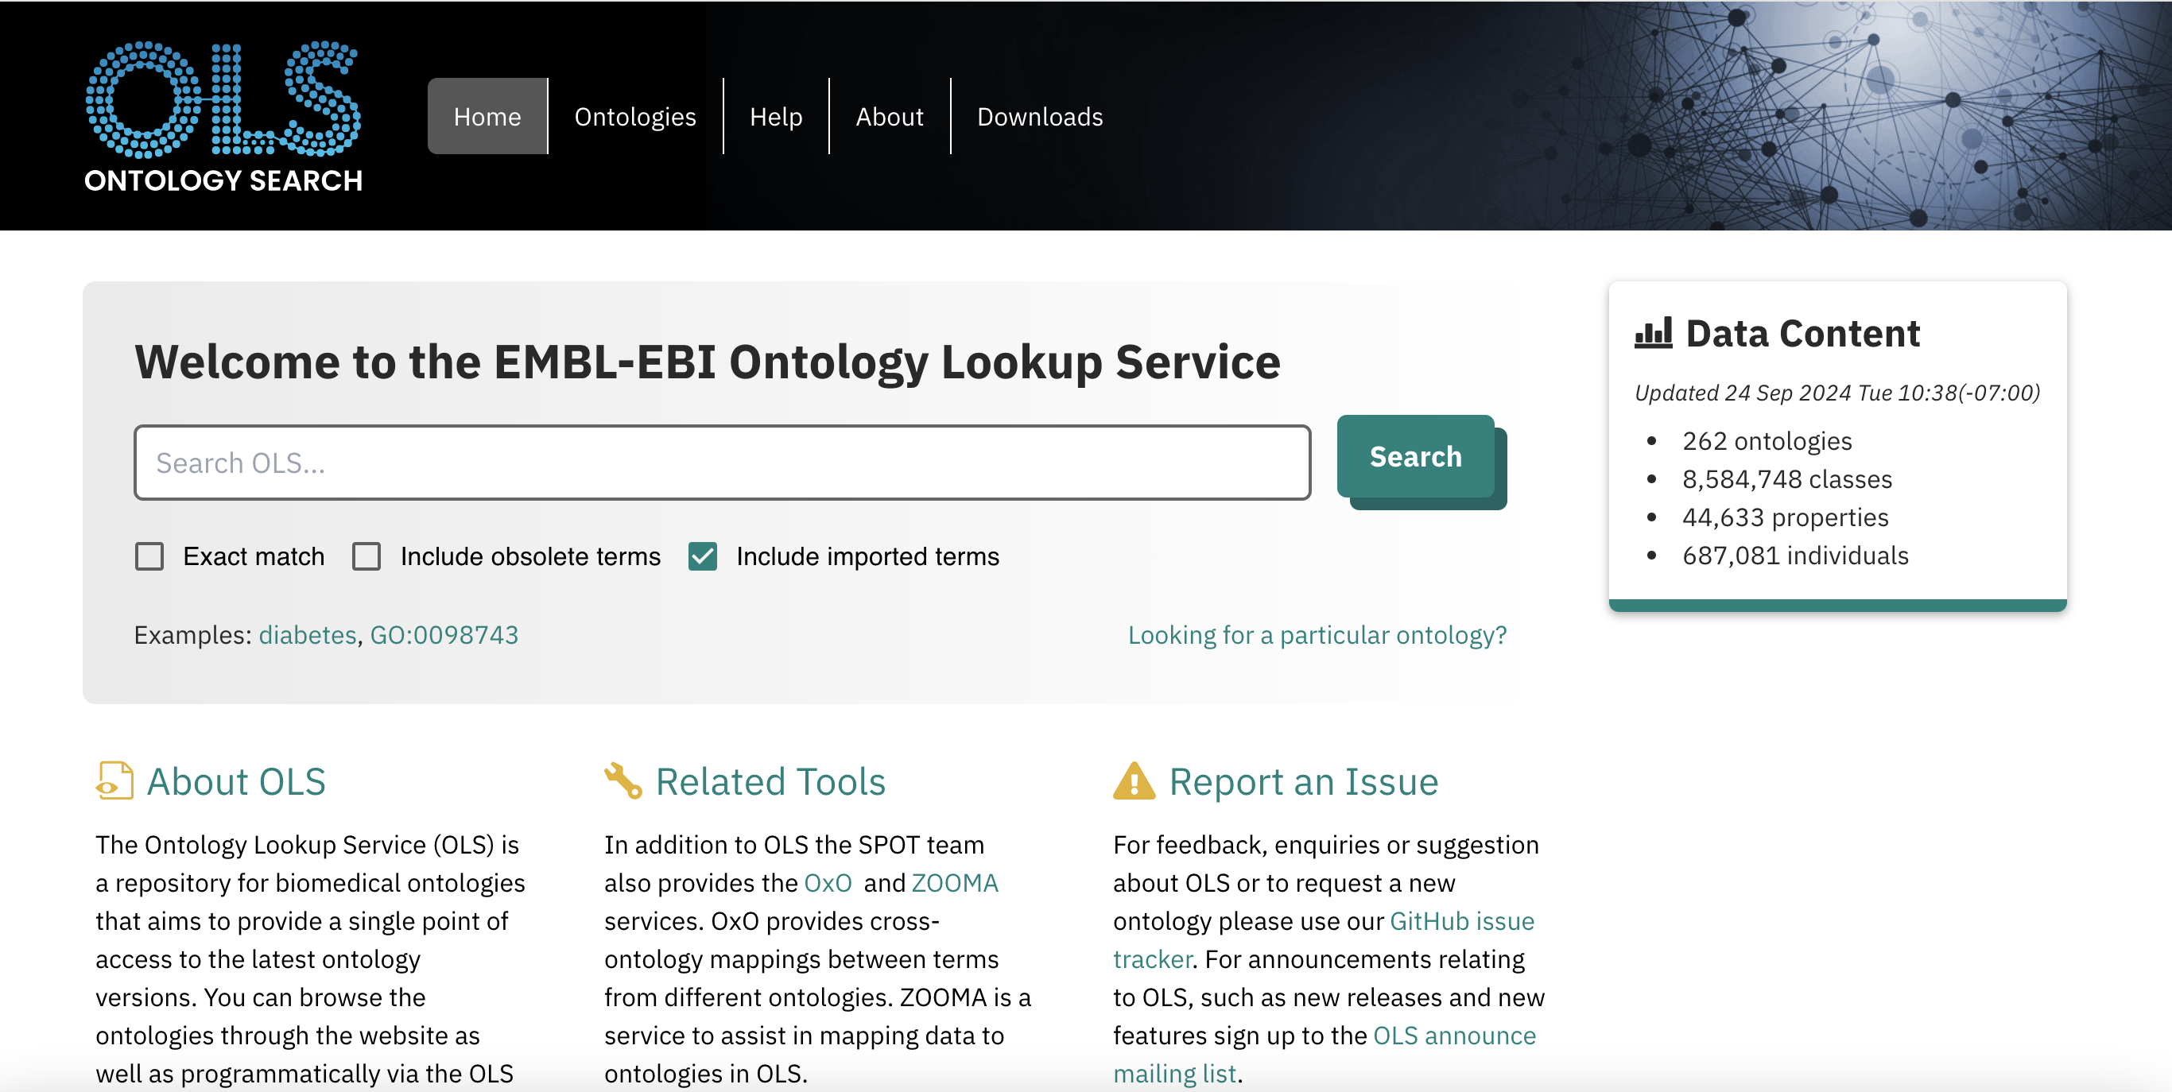
EBI Ontology Look-up Service
EBI OLS: https://www.ebi.ac.uk/ols4/

Slide 42
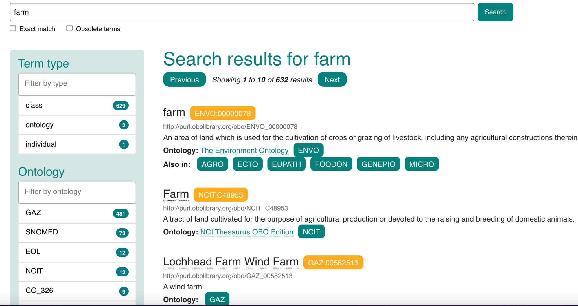
How to use EBI-OLS
Example: farm
Multiple hits!

Slide 43
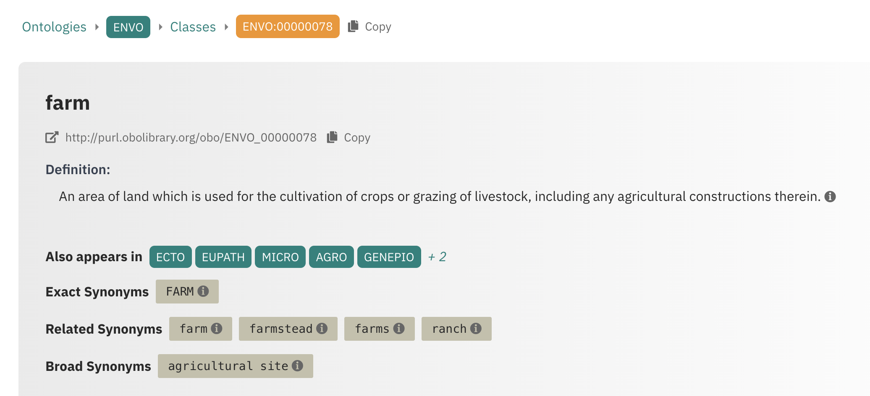
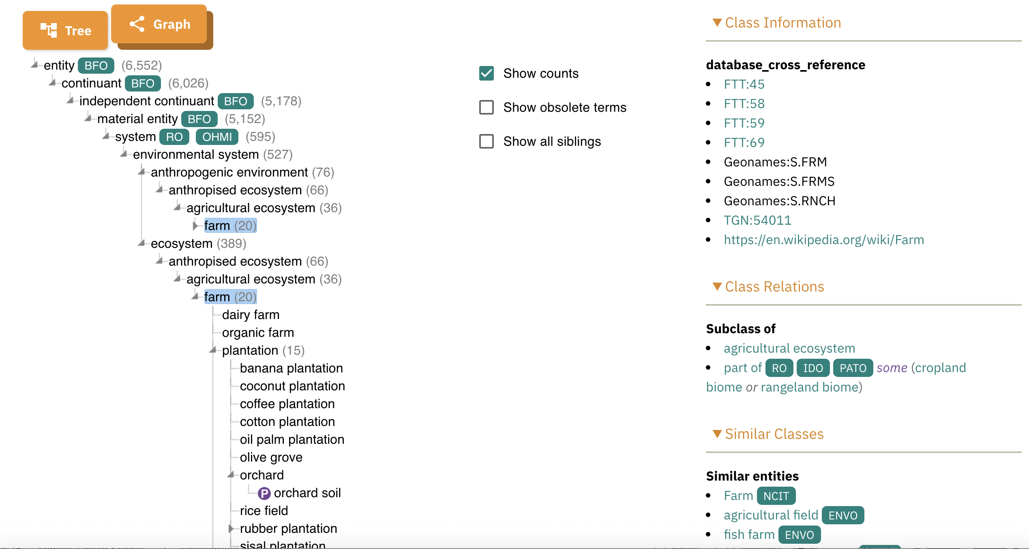
Click on any term to see synonyms, cross refs, hierarchy, class relations
What you need: label
Definition
ID

Slide 44
How do you select the right term?
Example: farm
Similar labels, different IDs
Different definitions
Different source ontologies
Ontologies that reuse the term

Slide 45
How to evaluate term matches
Searches for terms can yield many/different kinds of results. To evaluate the matches, ask yourself the following:
Does the match sound like what I’m looking for?
Is it a synonym, e.g. rocketship vs spaceship
Is it being defined by an ontology that makes sense with my use case?
A disease ontology is more appropriate for disease terms vs mouse model ontology
Does the definition sound right?
“Cell” could be room in a jail OR a basic unit of life
Is it specific enough? Too specific?
Cough vs productive cough vs productive cough (green sputum))
Is it reused in many different ontologies?
Hint: keep evaluating matches past the first hit

Slide 46
How do you select the right term?
Example: farm
“Farm” is exact match!
Def sounds right
ENVO (Environment) >
NCIT=Cancer
ENVO term in multiple ontologies
Conclusion: select
ENVO:00000078

Slide 47
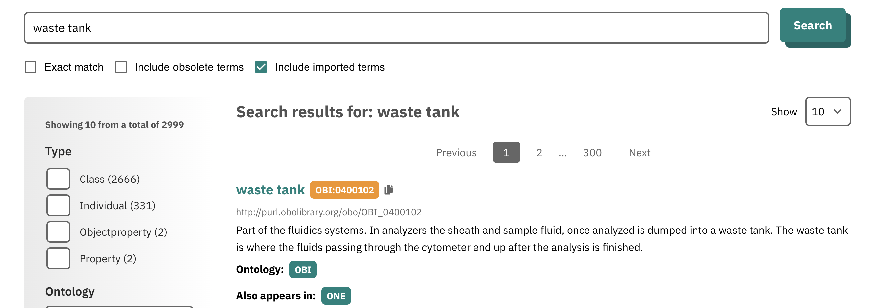
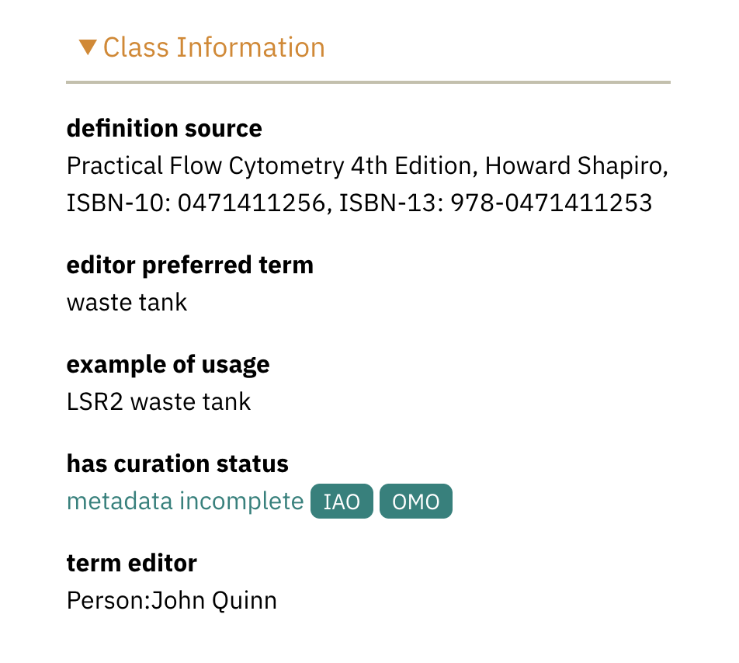
How do you select the right term?
Example: waste tank
(context of wastewater)
Label seems right
BUT
Definition is for flow cytometry
Don’t use this!
Try alternative…

Slide 48
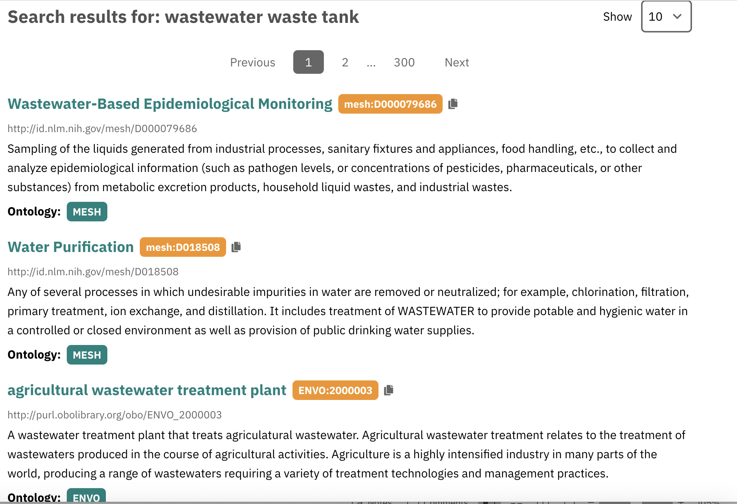
How do you select the right term?
Example: wastewater waste tank
No good match!
Identify a good ontology and file a New Term Request

Slide 49
Who do you trust? Evaluating ontologies…
All ontologies are not created equal. Ontologies can be built for specific project.
Advice for choosing ontologies to use:
Should be under active development (updated)
Should accept term requests from the community and respond in a timely manner
Should be interoperable and adhere to best practices (e.g. OBO Foundry)
The more widely used the better
Should provide definitions and sources
How do I know which ontologies are best?

Slide 50
Who do you trust? Evaluating ontologies…
Get advice. Chat with people. Some of our recommendations:
UO - units
NCBITaxon - taxonomy
ENVO - environment (built & natural)
OBI - assays, biological processes
FoodOn - food
DO - diseases
HP - symptoms
Uberon - anatomy
ChEBI - chemicals/drugs
GenEpiO – pathogen genomics, genomic epidemiology

Slide 51
Who do you trust? Evaluating ontologies…
Also, you can…
Check most recent activity (OLS, GitHub)
Check for documentation (term request form? README/publication?)
Check for the presence & quality of the definitions
As you do searches, keep an eye on how frequently terms appear in particular ontologies
(with a bit more experience) Check axioms and annotation status of terms

Slide 52
Summary
Ontologies are sources of standardized terms, specifications contain instructions for collecting data using the standardized terms, tools operationalize the specifications
There are different online tools to search ontologies and identify standardized terms (recommend EBI OLS)
To evaluate matches, check the ontology source is appropriate and the definition is correct
To source terms, choose well maintained ontologies
If you can’t find the term you need, try looking up synonyms
If all else fails, make a new term request

Slide 53
Practicum:
Finding new standardized terms

Slide 54
Part 3: Implementation and Testing
Lecture
Creating templates
Curation, validation, automated transformation: The DataHarmonizer
PHA4GE subgrants as mechanisms for testing
Data stewardship, Funding
Practical guidance: creating a specification, implementation in a tool, providing curation guidance
Practical exercise
SARS-CoV-2 template testing

Slide 55
Standards development: 10 Simple Rules
Step 1: Identify need for the specification
Define the challenge that could be solved by a new data standard.
Step 3: Perform a data needs assessment
Make a list of relevant stakeholders and conduct consultations. Review existing resources (standards, databases, collection instruments, etc.). Summarize anticipated analytical needs from different use cases.
Step 5: Develop interchange mappings
Facilitate data sharing by mapping to downstream databases. Use exchange formats and tools to automate transformations between resources.
Step 7: Testing, testing, and more testing
Iteratively test, review, and improve the specification package using real data, data collection, and data management practices.
Step 9: Update the specification as needs evolve
Use version control, document discussions, encourage transparency, engage the community for feedback, and track issues.
Step 2: Define the goal and scope of the specification
Identify specification scope, stakeholders, as well as content types and boundaries.
Step 4: Draft a preliminary schema using a consensus approach
Draft specification using existing terminology and formats. Develop new vocabulary following best semantic and ontology practices.
Step 6: Develop materials to support operationalizing the specification
Create reference guides and curation protocols. Integrate the specification in data management tools to create a clear path to implementation.
Step 8: Document real-world implementations
Gather real world examples of implementations to demonstrate utility and use.
Step 10: Encourage community participation in standards development
Share/disseminate novel standardized vocabulary and the complete specification schema.
Notes:
https://spec.cidgoh.ca/challenges

Slide 56

Supporting implementation: implementation science
*Data
*Tools
*People
Making your
data standard
actionable
Tooling
(Curation,
exchange)
Reference
guides
Curation
SOP
(decision tree)
Worked
examples
Training
materials
Mechanism
Community
Feedback

Slide 57


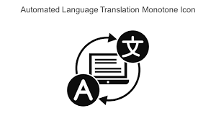

Strategies for implementation: implementation science
Making your
data standard
actionable
Spreadsheets
&
Curation tools
New databases
Existing databases
Standalone format for data sharing

Slide 58
Build Your Own Standard: An Overview
Step 5: Create your specification and implement it in a tool
1. Create your specification
e.g. consider LinkML (slots & enums, max/min, req status etc)
Select/create a tool and integrate specification as a data collection
template
e.g. DataHarmonizer templates

Slide 59
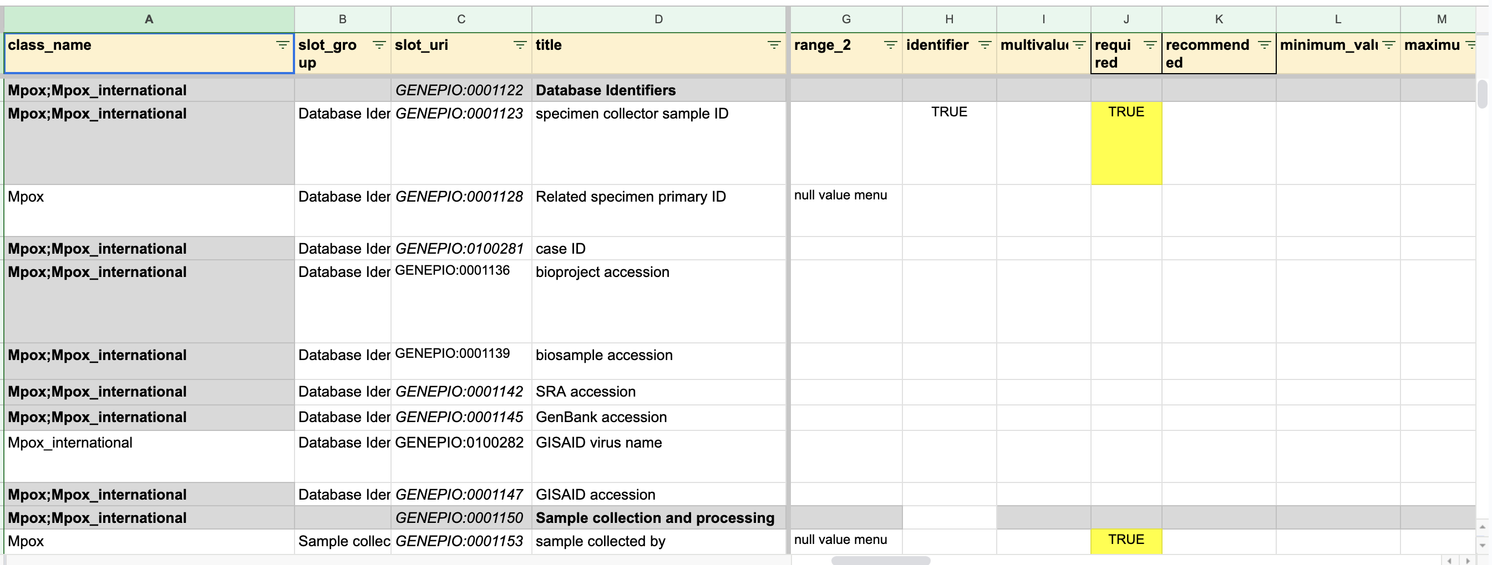
Turning controlled vocabulary into a specification
What you need to generate the Specification
Data types (string, enums, date, integer)
Need null value menus
Max/Mins
Multi-valued fields
Patterns (data formats, regex, capitalization)

Slide 60
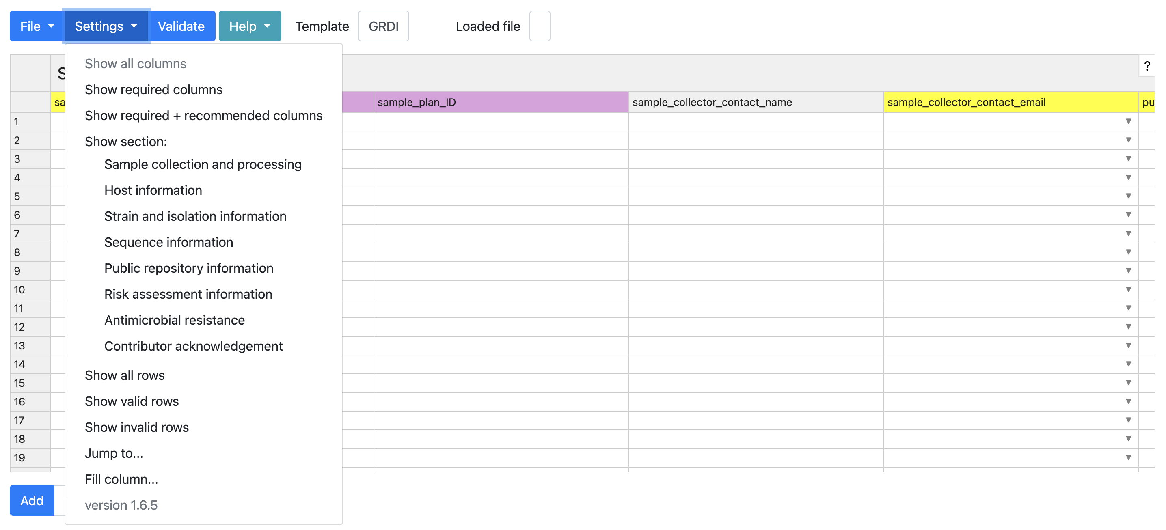
Implementation: DataHarmonizer curation & validation tool
Validate
(errors or missing info)
View all fields
View required fields
Move to desired field
Learn your way around the system
Double click on field labels for guidance on how to fill them
Save
Open existing file
Export to chosen format
LinkML-based spreadsheet-style text editor application
Specifications implemented as data collection templates
Colour-coded fields indicating minimal requirements
https://github.com/cidgoh/pathogen-genomics-package

Slide 61
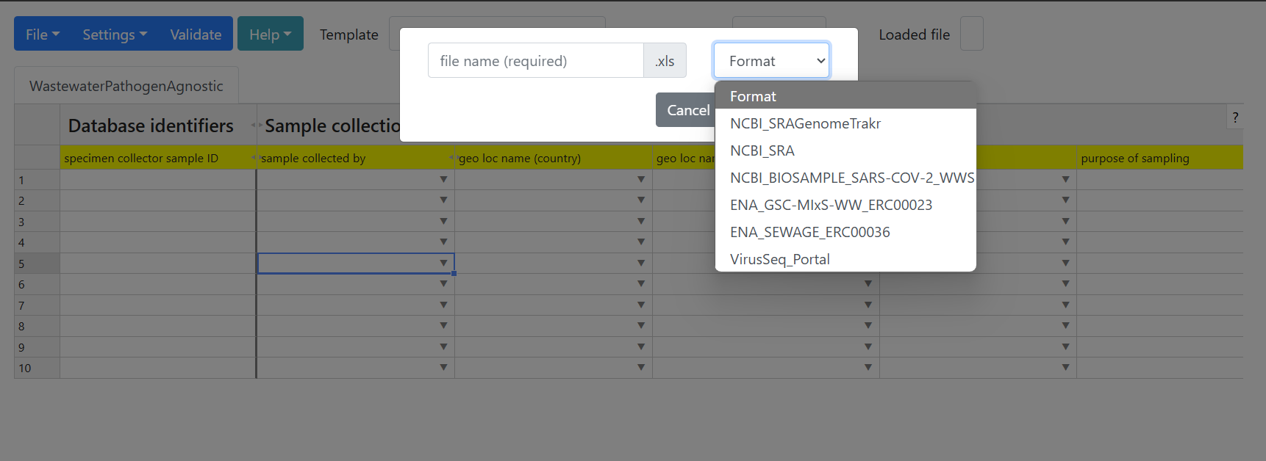

Data transformation is required for different downstream destinations of data. Exchange formats increase interoperability.
https://www.microbiologyresearch.org/content/journal/mgen/10.1099/mgen.0.000908
Enter data once, export for different uses!
NCBI SARS-CoV-2 wastewater surveillance checklist
ENA sewage checklist
GSC wastewater/sludge checklist
PHES-ODM
No one standard/format to rule them all.

Slide 62
Other data curation tools
METAGENOTE
Multisub
eLwazi Metadata Harmonization Tool
LexMapr
ZOOMA
ChatGPT
RedCap databases

Slide 63
Build Your Own Standard: An Overview
Step 6: Create supporting/reference materials
Develop reference guides (define all the terms – reuse as much as possible)
Develop the curation protocol (reuse as much as possible, include any curation lessons learned from looking at the messy data)
Create worked examples
Use PHA4GE REFERENCE MATERIALS as examples.
(e.g. SARS-CoV-2, Wastewater, hAMRonization, QC tags)

Slide 64
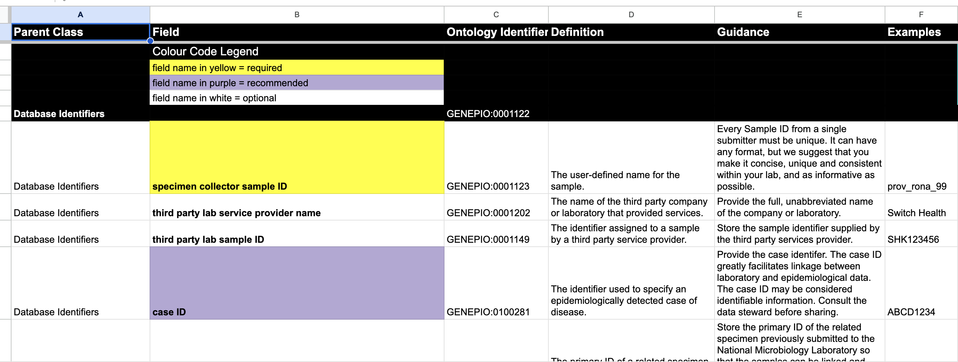
Creating a reference guide: What you need.
Preferred label
Data collection priority (required, recommended, optional)
Ontology ID
Definition
Guidance (how you want people to use the data element; field or term)
Examples of use

Slide 65
Data stewardship, ethical sharing, and equitable benefits
Guidance in standards – Reference Material
Privacy protection
Public trust essential, loss of trust has consequences (protection, transparency)
De-identified data (no names/addresses)
Be careful of 1) small case numbers 2) geo_loc/time geographical granularity 3) combinations of fields
Track identifiers (chain of custody), but personal health IDs/sample IDs may be considered PHII
Consult privacy officer (jurisdictional policies, national legislation)
Security and Quality
Provenance, methods (rich details): attribution, auditability, reproducibility (track methods), accountability
Contextual data may require storage with higher security than seq data
Errors corrected, update as required

Slide 66
Types of contextual data critical for surveillance/ genomic epidemiology (what you can most likely share)
Geo_loc (at least country, preferably state/province) – sample collection
Sample collection date (to the day)
Attribution: Who collected sample, who sequenced it
Methods: instrument (platform & model), consensus sequence software, coverage
Sampling strategy (random sampling, targeted sampling, outbreak, research)
Host
Demographics: host age/gender
Sample type & sampling method (anatomical, environmental, food, devices, methods)
Quality/diagnostic indicators (e.g. Ct values)
Vaccination
Exposures
Travel history
Hospitalization
Outcomes

Slide 67
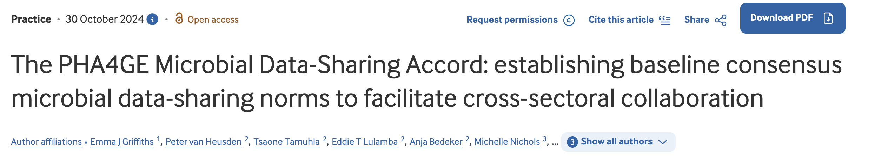
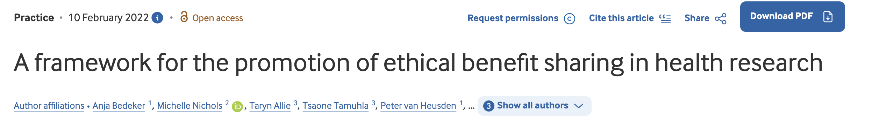
References for best data stewardship practices and equitable benefit sharing

Slide 68
Build Your Own Standard: An Overview
Step 7: Test it in real world settings
Develop a curation exercise that tests:
Data standard content
Tooling
Instructional materials
Can be based on synthetic data or real participant’s own data
Create a feedback form
Identify participants and incentivize participation (e.g. payment, authorship)
Have a defined testing period and collect/summarize feedback
Act on feedback
Use the WW TESTING INSTRUCTIONS and FEEDBACK FORM as examples.

Slide 69

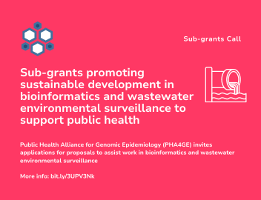
Wastewater surveillance specification testing
Subgrant awards: Testing exercise
Nepal South Africa Ethiopia Pakistan Côte d'Ivoire India Kenya Argentina Cameroon Mexico
Feedback: worked examples most helpful, additional vocabulary (sampling sites), customize templates
Case studies: Argentina, Kenya

Slide 70
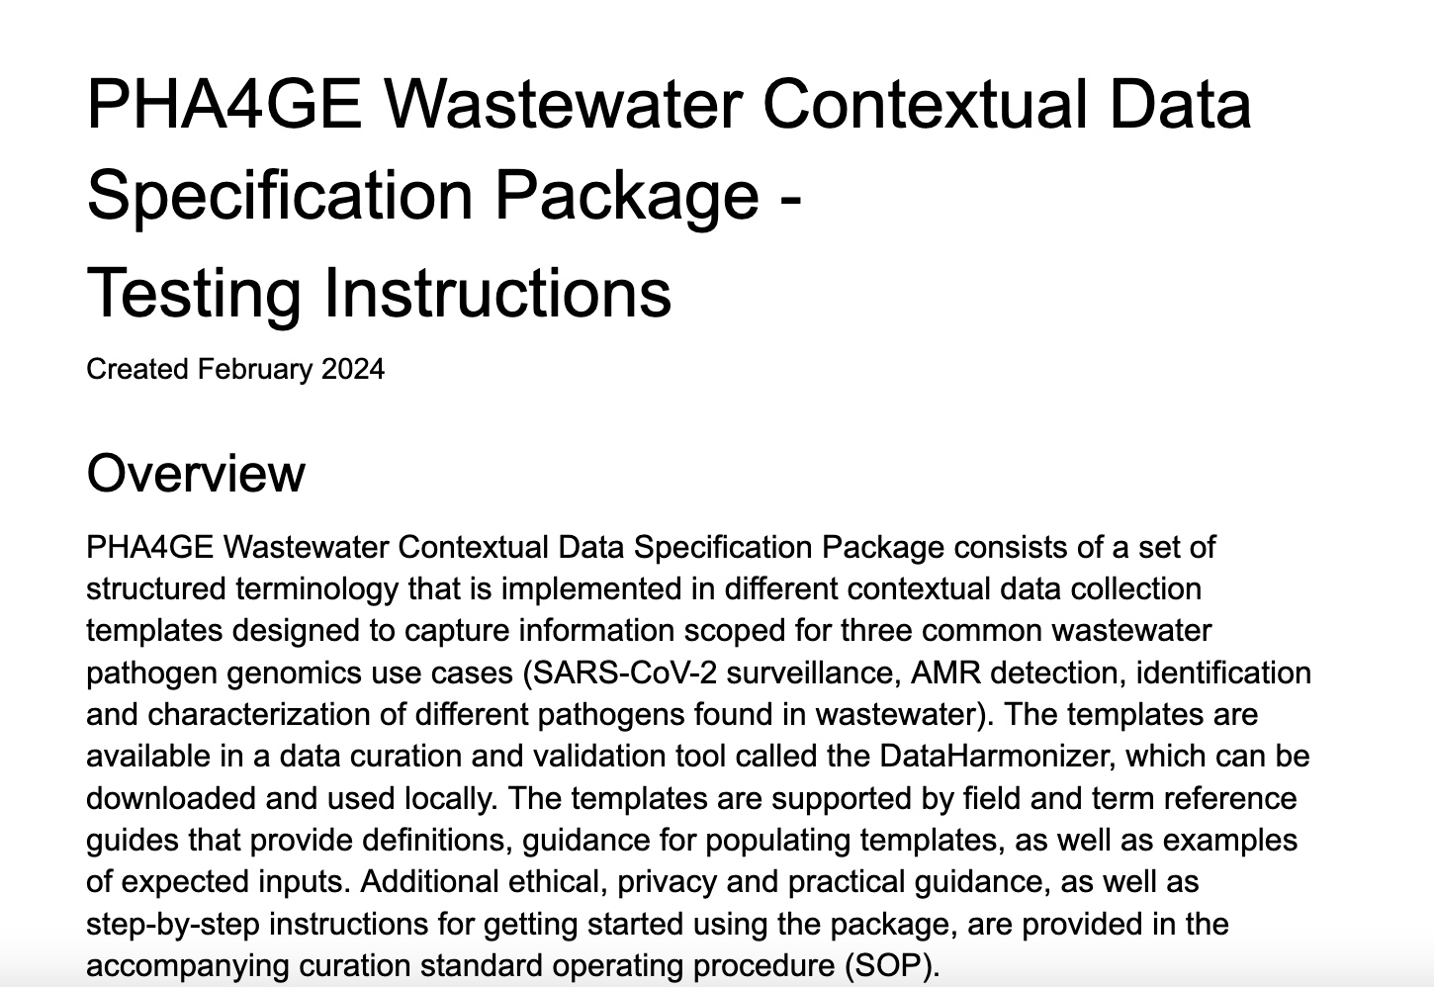
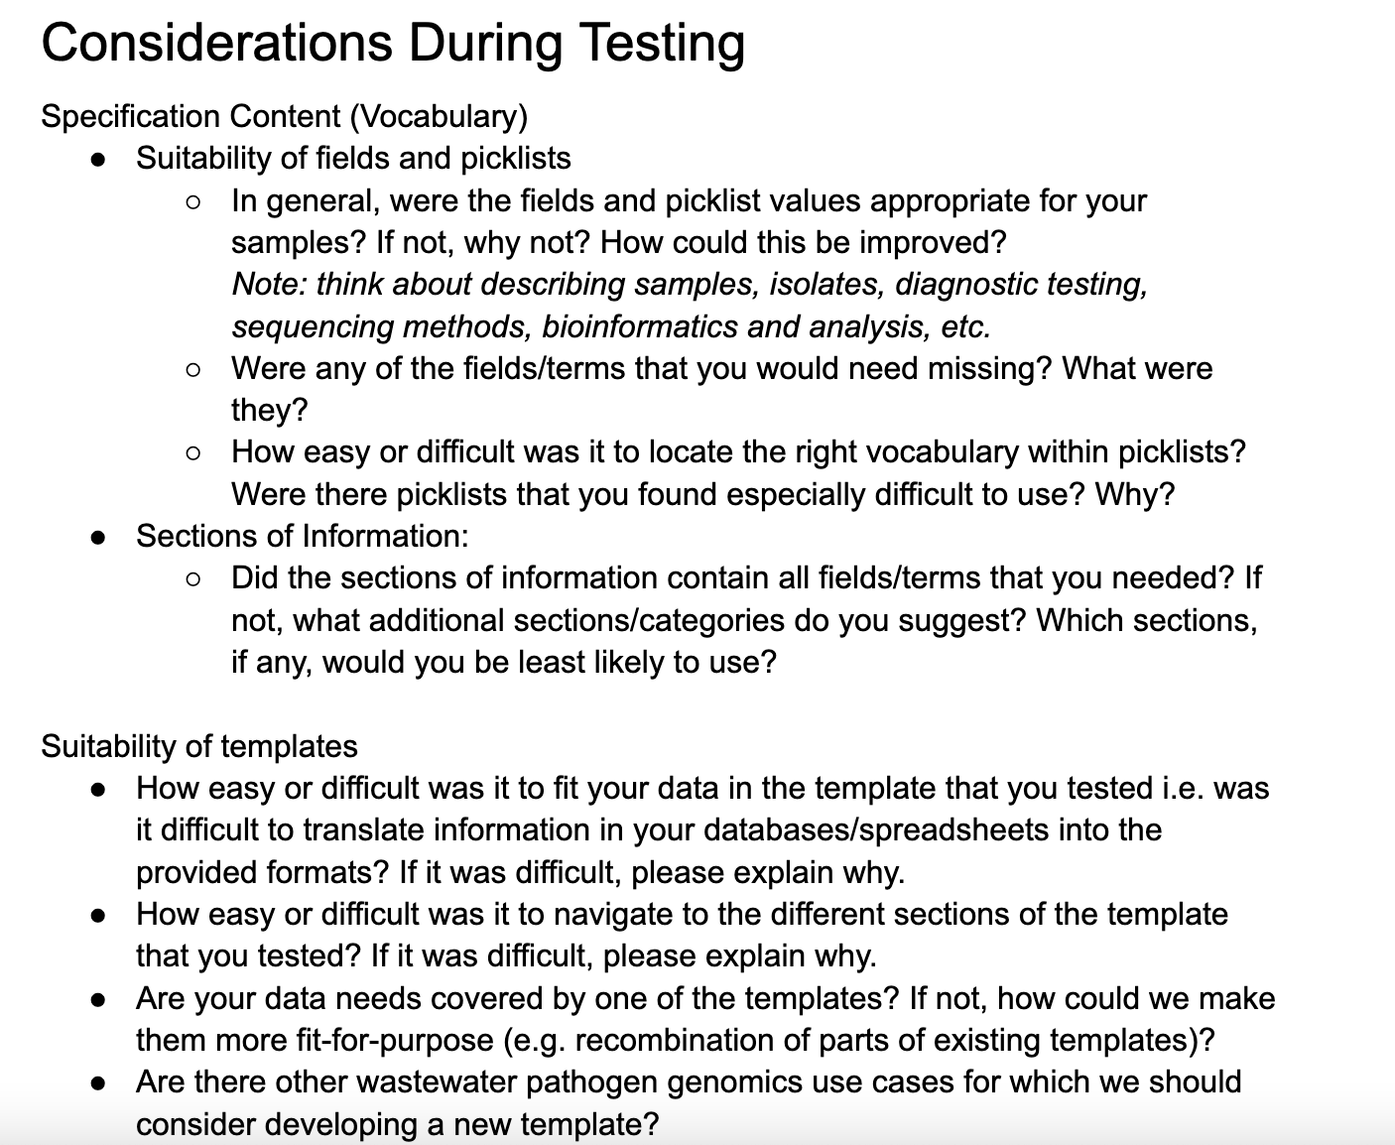
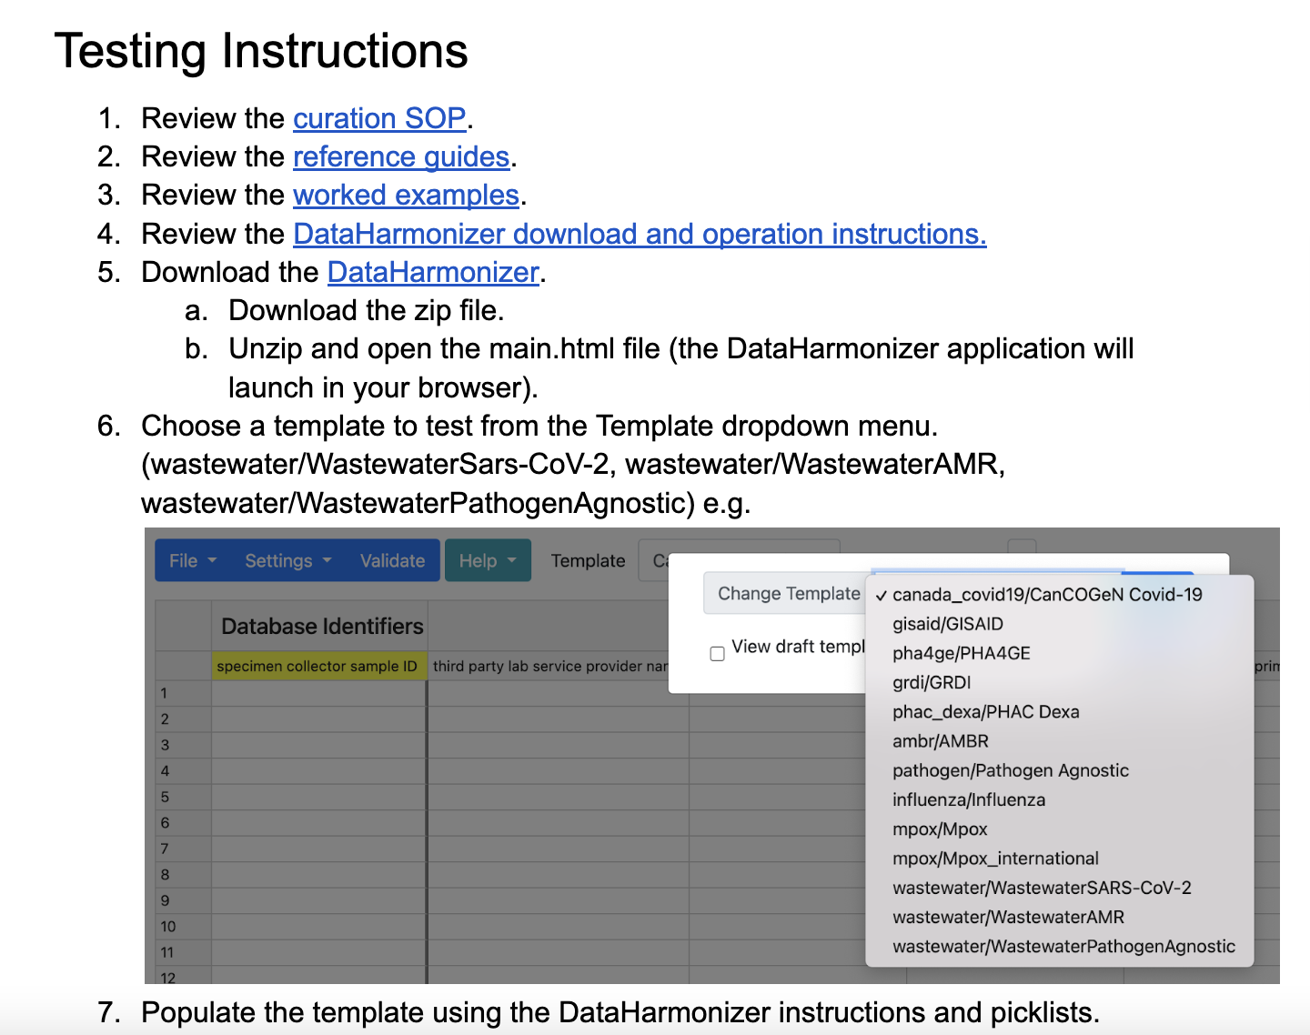
Feedback form
Testing Instructions

Slide 71
Practicum:
DataHarmonizer Demo &
Example Curation Exercise

Slide 72
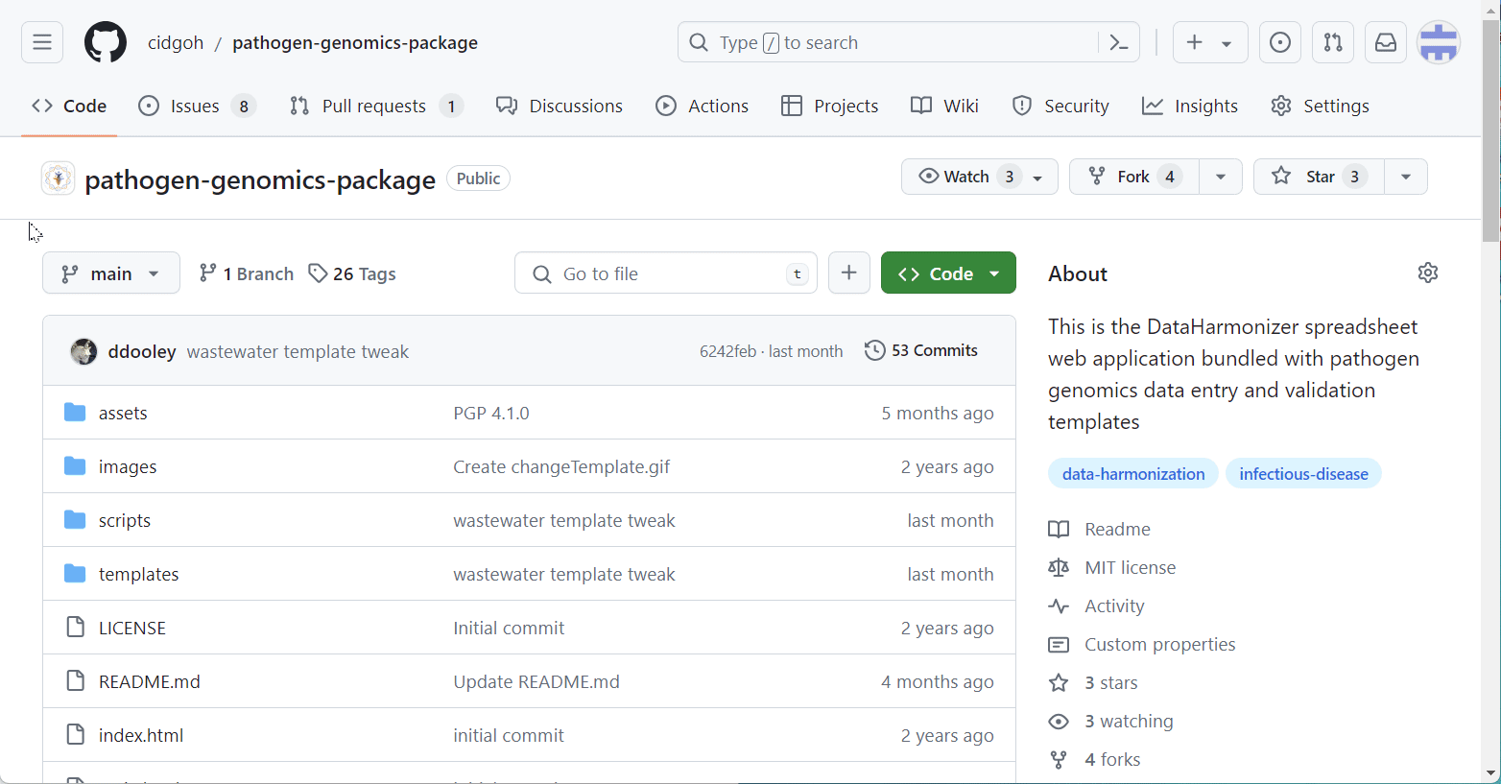
Demo Time: DataHarmonizer
Download and unzip from https://github.com/cidgoh/pathogen-genomics-package/releases/tag/PGPv5.1.0

Slide 73

Open the PHA4GE template in the DataHarmonizer
Template -> PHA4GE

Slide 74
Scenario : Clinical SARS-CoV-2 Data
The BCCDC Public Health Laboratory obtained a nasopharyngeal swab for diagnostic testing (sample ID Bc-12345-ab) on March 1 2023 from a symptomatic, 44 year old female that had been hospitalized in the ICU. The individual had been exhibiting a cough, fever, muscle weakness, as well as other symptoms of Acute Respiratory Distress Syndrome.
The individual recently travelled to the United States on holiday and returned on Feb 19 2023. The sample was flagged for sequencing as part of the lab’s International travel surveillance program. The sample was sequenced on March 7 2023 using an Illumina MiSeq instrument. The raw data was processed using ncov-tools 2.3.1 as part of their bioinformatics protocol (https://github.com/jts/ncov2019-artic-nf/blob/master/README.md) and dehosted using BWA (version 0.7.17). The consensus sequence was generated using iVar 2.3.1. The sequence was uploaded to GISAID and assigned the accession number EPI_ISL_436489. Drs Tejinder Singh, Fei Hu and Joe Blogs helped to generate the sequence.

Slide 75
Scenario : Clinical SARS-CoV-2 Data
Sample collection and processing
sample collected by: BCCDC Public Health Laboratory
sequence submitted by: BCCDC Public Health Laboratory
sample collection date: 2023-03-01
sample collection date precision: day
geo_loc name (country): Canada
geo_loc name (state/province/territory): British Columbia
organism: Severe acute respiratory syndrome coronavirus 2
isolate: hCoV-19/CANADA/BC-Bc-12345-ab/2023
purpose of sampling: Diagnostic testing
purpose of sampling details: Not Provided
anatomical material: Not Applicable
anatomical part: Nasopharynx (NP)
body product: Not Applicable
environmental material: Not Applicable
environmental site: Not Applicable
collection device: Swab
collection method: Not Applicable
Database identifiers
specimen collector sample ID: Bc-12345-ab
GISAID accession: EPI_ISL_436489
Sequencing
purpose of sequencing: International travel surveillance
purpose of sequencing details: Not Provided
sequencing date: 2023-03-07
sequencing instrument: Illumina MiSeq
Host information
host (scientific name): Homo sapiens
host health state: Symptomatic
host health status details: Hospitalized (ICU)
host disease: COVID-19
host age: 44
host age unit: year
host age bin: 40 - 49
host gender: Female
signs and symptoms: Cough; Fever; Muscle weakness; Acute Respiratory Distress Syndrome
Bioinformatics and QC metrics
raw sequence data processing method: ncov-tools 2.3.1
dehosting method: BWA 0.7.17
consensus sequence software name: iVar
consensus sequence software version: 2.3.1
bioinformatics protocol: https://github.com/jts/ncov2019-artic-nf/blob/master/READM
Host exposure information
destination of most recent travel (country): United States of America
most recent travel return date: 2023-02-19
Contributor acknowledgement
authors: Tejinder Singh; Fei Hu; Joe Blogs

Slide 76
Build Your Own Standard: An Overview
Step 8: Ensure standards development is part of initial experimental design and that the work is sufficiently resourced
Include standards development in initial budgeting
Make sure you have enough money
Make sure you have the enough personnel with the right expertise
Should be part of DATA MANAGEMENT PLANS.
Development requires EXPERTISE, FUNDING AND PERSONNEL.
COSTING TOOL under development.

Slide 77
Funding standards development
Task | Considerations
Scoping (including lit/standards review) | Identify potential users.
Needs assessment | Assessment questionnaire needs to be customized, might need research ethics review, need summary/report (gap analysis).
Compiling necessary vocabulary | Workload can be extensive if scope is wide and target data types are complex and/or there are many new modules/elements.
Sourcing standardized fields/terms | May need to create a lot of new ontology terms.
Specification development | Can take time to develop guidance specific to standard.
Tool development/implementation | Can be work-intensive. May require software developers.
Developing support materials | Non-trivial. A standard is only as good as its implementation.
Testing (include stipends) | Can require a lot of support. Stakeholders should be provided an opportunity to give feedback as well.
Iterative development (updates based on feedback) | Can be non-trivial. May require work on standard, support materials, and/or tooling.
Develop NTR system, maintenance plan, and accessibility plan (beyond initial funding period) | Share with PHA4GE/IPSN data standards registry, publish on GitHub, publish manuscript
Develop dissemination/knowledge translation plan | Training sessions, videos
RULE OF THUMB: (depends on complexity/experience) 1-2 years and 150KCAD

Slide 78
Summary: Benefits of contextual data standards
Establishes a quality framework for contextual data
-auditability, chains of custody
-future-proofing assets
Part of best practices
-WHO (Guiding Principles for Genomic Data Sharing, 2022)
-FAIR (Findable, Accessible, Interoperable, Reusable)
Improves efficiency
-save time/money (80:20 data science rule)
-human/machine-readability
-streamlines data exchange
Empower investments contributing to local/national/global surveillance
-breaking down barriers (coordination, communication, data flow)

Slide 79
End of workshop!
QUESTIONS?
Find all out resources at:

